Slide 1
Gestational diabetes
Type of diabetes that occurs during the second or the third trimester of pregnancy
Caused by hormones made by the placenta that prevents the body from using insulin effectively
Usually goes away after delivery but can ↑ chance of developing type 2 diabetes
Risk factors include :
Obesity
Lack of physical activity
Previous gestational diabetes or prediabetes
Diabetes in an immediate family member
Previously delivering a baby weighing more than 9 pounds
Race – Women who are Black, Hispanic, American Indian and Asian American have a higher risk of developing gestational diabetes

Slide 2
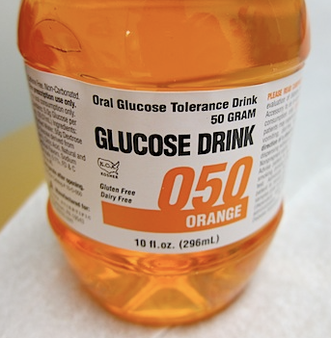
Gestational diabetes - Screening
Glucose tolerance test – Used to determine body’s response to glucose
Done between 24-28 weeks of pregnancy
50g glucose : random glucose done 1h after drinking a solution containing 50g of glucose. If normal, no further testing to be done
If 50g test high : need to do 75g glucose test
Necessary to be fasting for at least 8h
3 blood tests : 1 fasting glucose – patient drinks 75g glucose liquid – blood test 1h after – blood test 2h after
If positive, can be treated with diet only or require insulin injections

Slide 3
Gestational diabetes - Classification
GDMA1 : Diet controlled
GDMA2 : Patient needs insulin injection to control diabetes
3 different protocols:
GDMA1 or GDMA2 requiring less than 30 units of insulin daily
GDMA2 requiring more than 30 units of insulin daily
Patients with pre-existing diabetes type 1 or 2

Slide 4
Gestational diabetes – Possible complications
Preeclampsia or GHTN
Hypoglycemia on newborn
Baby large for gestational age (Macrosomia), increasing need for a C/S
Possible birth injury d/t baby’s size and difficulties during delivery

Slide 5
Hypoglycemia protocol – Risk factors
Gestational age less than 37 weeks
Small for gestational age (birth weight below 10th percentile)
Identified as intrauterine growth restriction (IUGR) during the pregnancy, EVEN IF NORMAL BIRTH WEIGHT
Large for gestational age (birth weight above 90th percentile)
APGAR score of less than 6 at 5 minutes
Infant of diabetic mother (Type 1 and 2, gestational diabetes treated with diet, oral hypoglycemic agent or insulin)
Beta-blockers administration to mother during pregnancy (ex : labetalol, propranolol, metoprolol)
Betamethasone (Celestone) administration to mother during the last week of pregnancy

Slide 6
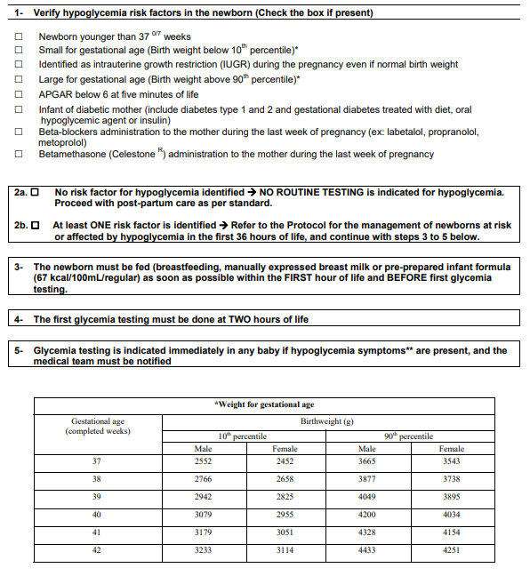

Slide 7
Hypoglycemia protocol - Symptoms
Hypothermia (axillary temperature lower than 36.5) despite warming measures
Jitteriness and/or tremors
Seizures and/or eye-rolling
Weak and/or high-pitched cry
Limpness and/or lethargy
Cyanosis, intermittent apneic spells, and/or tachypnea
Feeding difficulty and/or poor suck
Diaphoresis
Sudden pallor

Slide 8
