Slide 1
Gestational Diabetes
Antepartum Session

Slide 2
Objectives
What is GDM?
Pathophysiology
Risk factors
Classification system
Management
Follow-up & Prevention

Slide 3
Gestational Diabetes Mellitus
Definition
Pregnancy is a state of increased pancreatic beta-cell function AND of progressive insulin resistance
The placenta produces diabetogenic hormones to reduces glucose entry in maternal cells
GDM develops when beta-cell function is insufficient to overcome insulin resistance.
https://www.youtube.com/watch?v=UIQgolIGQEU
UpToDate, 2024

Slide 4
Gestational Diabetes Mellitus
Prevalence
GDM affects between 3-20% of pregnant patients
In Canada, around 14% of pregnant patients
    Making it one of the most common complication of pregnancy
In 90% of cases, it disappears after birth.
Pt diagnosed with GDM are a greater risk to develop Type II diabetes
    Pt should be tested P.P. and q3 years or more, depending on risk factors
    Majority have a form of glucose intolerance that could be
      limited to pregnancy,
      chronic and stable, or
      stage in progression to diabetes
Diabetes Quebec, 2024; Diabetes Canada, 2024; Nethery et. Al, 2023

Slide 5
Why Is It Important ?
Gestational Diabetes Mellitus
Diabetes in pregnancy is associated with an increased risk of complications in both mother and fetus.
  Increase risk of Polyhydramnios, c/s rate, post-op infections, PET, developing Type II, cardiovascular disease
  Increase risk of SAB, LGA (asymmetric accelerated growth), birth injuries, neonatal hypoglycemia,NICU admissions, stillbirth, obesity in the offspring
    Diabetic embryopathy (birth defects and spontaneous abortions) occurs in 6th to 7th week of gestation
    Diabetic fetopathy (i.e. macrosomia and fetal hyperinsulinemia) occurs in the 2nd and 3rd trimester
For Pregestational Diabetic Patients
UpToDate, 2024

Slide 6
Why Is It Important ?
Gestational Diabetes Mellitus
Diabetic fetopathy: Occurs in the 2nd and 3rd trimesters, and results in a group of features seen in the hyperinsulinemic fetus of a diabetic mother that include macrosomia, postnatal hypoglycemia and polycythemia
    Maternal hyperglycemia → Fetal hyperglycermia → Fetal hyperinsulinemia → Neonatal hypoglycemia
    Animal studies have shown that chronic fetal hyperinsulinemia results in elevated metabolic rates → increased oxygen consumption and fetal hypoxemia. As the placenta may be unable to meet the increased metabolic demands → Increased erythropoiesis → altered cardiac and neurologic development (e.g. ventricular hypertrophy)
      2/3 of congenital anomalies due to GDM impact the cardiovascular system of the CNS
UpToDate, 2024

Slide 7
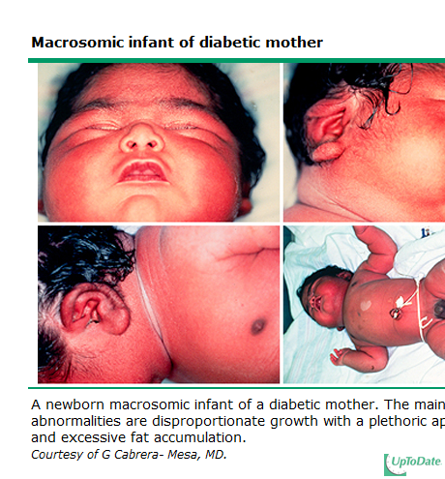
Why Is It Important ?
Gestational Diabetes Mellitus

Slide 8
Maternal Risk Factors
Gestational Diabetes Mellitus
History of gestational diabetes in previous pregnancy
    40% risk of recurrence
Family history of diabetes
Prepregnancy BMI ≥ 30
Maternal age > 35
Previous unexplained perinatal loss
Medical condition associated with the development of diabetes (PCOS, HTN, auto-immune disease etc)
Ethnic group with higher type 2 diabetes
    Hispanic-american, afro-american, native american, south or east asian, pacific islander
Diabetes Quebec, 2024; UpToDate, 2024

Slide 9
Management
Gestational Diabetes Mellitus
Standardized and Systematic Screening
A1C testing in early pregnancy (A1C ≥ 6.5)
Glucose Tolerance test at 24-28 weeks of pregnancy
    50g (Random Glucose level 1h PC)
      if Glucose level ≤7.7 → Not GDM
      if ≥ 11.1 mmol/L → GDM
      if ≥ 7.8-11.0 → Do 75g OGTT
    75g (NPO, Glucose level AC, 1h PC, and 2h PC)
      if Glucose level ≥ 5.3 (NPO), or ≥ 10.6 (1h PC), or 9.0 (2h PC) → GDM
SOGC, 2019

Slide 10
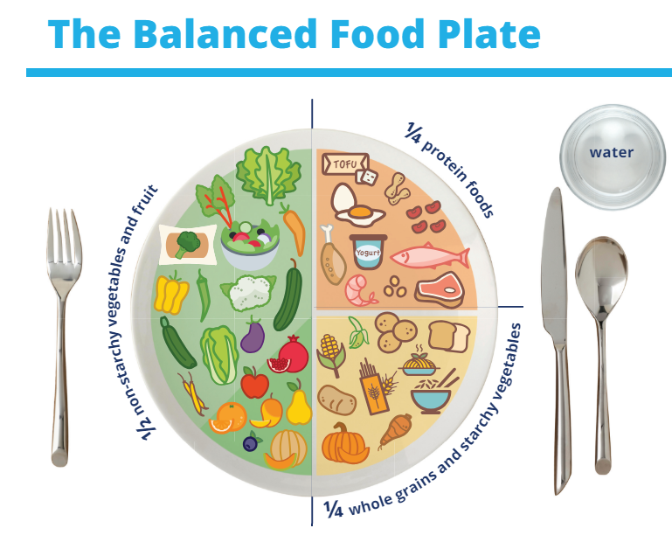
Management GDMA1
Gestational Diabetes Mellitus
Nutritional Therapy (in combination with healthy lifestyle)
  With a dietician
  Achieve normoglycemia
  Prevent ketosis (when the liver starts to burn fat instead of carbohydrates, it produces ketones)
  Provide adequate weight gain (portion control and proper distribution of carbohydrates)
  Contribute to fetal well being
  Glucose level monitoring
Diabetes Canada, 2024; Diabetes Quebec, 2024

Slide 11
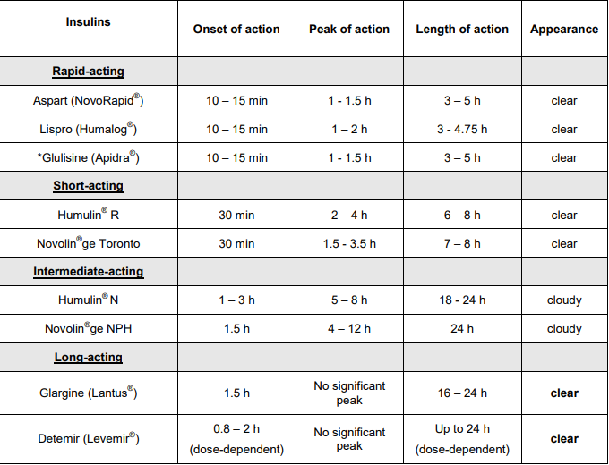
Management GDMA2
Gestational Diabetes Mellitus
Insulin Therapy and Oral antihyperglycemic medication

Slide 12
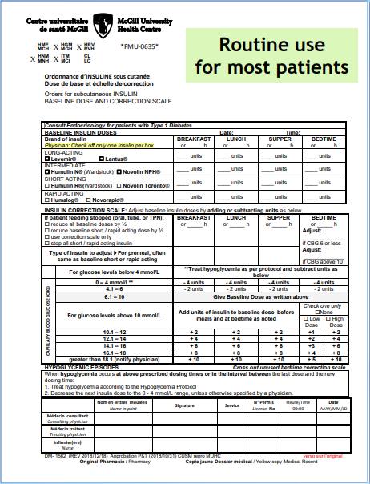
Management
Gestational Diabetes Mellitus
Insulin Therapy – Insulin Correction Scale

Slide 13
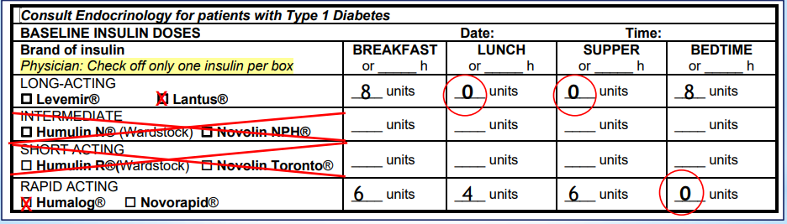
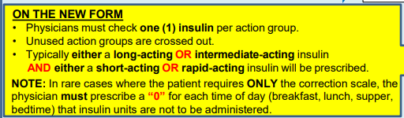
Management GDMA2
Gestational Diabetes Mellitus
Insulin Therapy – Insulin Correction Scale

Slide 14
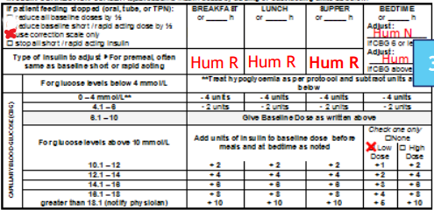
Management GDMA2
Gestational Diabetes Mellitus
Insulin Therapy – Insulin Correction Scale

Slide 15
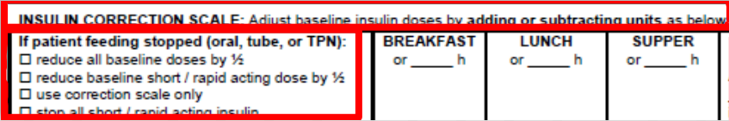
Management GDMA2
Gestational Diabetes Mellitus
Insulin Therapy – Insulin Correction Scale
Daytime
      https://www.youtube.com/watch?v=ng6ecsxfUaU
Bedtime
      https://www.youtube.com/watch?v=YwC-5xX00P0&feature=youtu.be

Slide 16
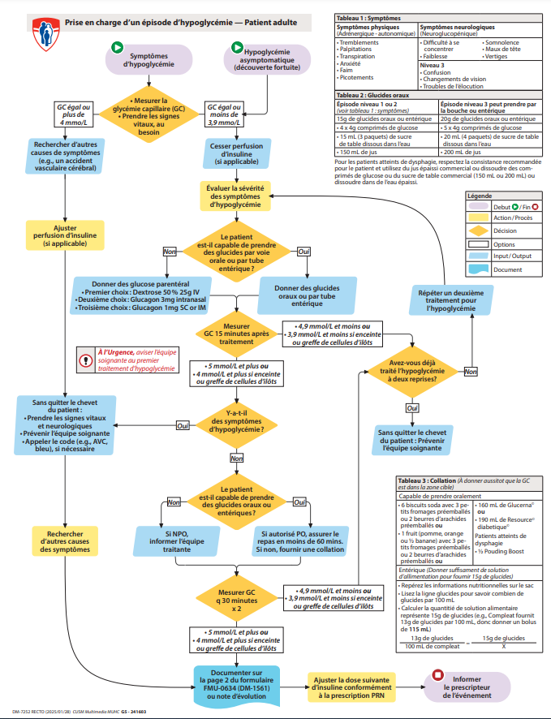
Management GDMA2
Gestational Diabetes Mellitus
Management of hypoglycemia episode
    https://www.moncusm.muhc.mcgill.ca/node/33063

Slide 17
Intrapartum Management
Gestational Diabetes Mellitus
Women should be closely monitored during labour and delivery, and maternal blood glucose levels should be kept between 4.0 and 7.0 mmol/L in order to minimize the risk of neonatal hypoglycemia
  MUHC target: 4.5-5.5 mmol/L
  Women should receive adequate glucose during labour in order to meet their high-energy requirements
Patients will come with their own pre-printed orders from Endocrinologist
Latent Phase
  Minimal change in maternal demands
Active Phase
  Should be viewed as intense exercise, with increase use of energy and a decrease need of insulin

Slide 18

Intrapartum Management
Gestational Diabetes Mellitus
Diabetes poorly controlled
  Require larger dose of insulin
  Newborns are likely to have severe and prolonged hypoglycemia (Diabetic fetopathy)
  Normoglycemia during labor cannot prevent neonatal hypoglycemia

