Slide 1
ANTEPARTUM ORIENTATION
Day 2
ANTENATAL CARE
Slides from presentation by Malisa Khongkham, RN, MSc, NPDE
Adapted by Elisabeth Chailloux, NPDE, MScN, candidate

Slide 2
Antenatal Assessment
  Maternal age
  Gestational age
  Previous obstetrical history
  Presence/ absence of underlying current medical conditions and/ or obstetrical complications.
  Other risk factors such as smoking, drugs and/or alcohol, physical or sexual abuse
  Social and Psychosocial situation

Slide 3
Routine Prenatal Tests
First trimester
  Nuchal translucency
  Prenatal bloods
  First ultrasound around 12 weeks
Second trimester
  Amniocentesis (PRN)
  Ultrasound (20-22 weeks)
  Glucose screen (26-28 weeks)
Third trimester
  Win-rho (PRN)
  Ultrasounds (PRN)

Slide 4
Routine Prenatal Blood Tests
CBC (Hgb, Platelets)
Blood Group/ antibody screen
Hgb electrophoresis (sickle cell, thalassemia)
Serologies
  - HIV AB/AG screen
  - Hepatitis B surface antigen
  - Syphilis screen (EIA) VDRL
  - Rubella IGG
TORCH
- Toxoplasmosis
- Rubella
- Cytomegalovirus
- Herpes simplex
- HIV

Slide 5
Second Trimester Ultrasound
Assists in predicting gestational age
Provides a visual assessment of the intrauterine environment
Used to assess fetal organ development
Ultrasound provides information about fetal growth rate, quality of activity, volume of amniotic fluid, or a biophysical profile evaluation

Slide 6
Antepartum Fetal Health Surveillance

Slide 7
The SOGC (2018, 2023) recommends the following six antenatal surveillance techniques, some of which that can be done simultaneously, and usually performed in a hierarchical fashion:
Fetal movement awareness (ALL WOMEN)
Fetal movement counting (ALL WOMEN, starting at 26 weeks)
Non-stress testing (NST)
Contraction stress test (CST)
Biophysical Profile (BPP)
Maternal uterine artery Doppler (Done during the anatomy scan)
Fetal umbilical artery Doppler (In women with suspected placental pathology)

Slide 8
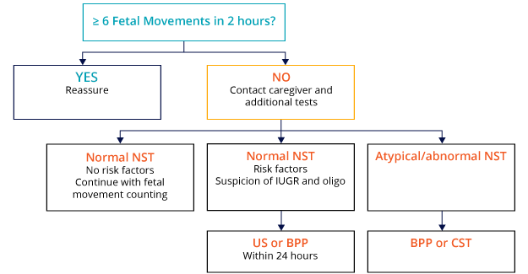

Slide 9
Fetal Movement Counting
Initiated at 26 – 32 weeks gestation
Based on the premise that the fetus reduces or stops movement in response to chronic hypoxia in an attempt to reduce oxygen consumption and conserve energy
Ingestion of food and glucose does not increase fetal movements
Maternal smoking, use of depressant drugs, narcotics and corticosteroid injections may decrease fetal movements
Decreased fetal movement is described as <6 distinct movements within 2 hours
Notes:
SOGC???????

Slide 10

Fetal Movement Counting
SOGC (2007) recommendations:
Daily monitoring of fetal movements starting at 26 to 32 weeks should be done in all pregnancies with risk factors for adverse perinatal outcome. (I-A)
Healthy pregnant women without risk factors for adverse perinatal outcomes should be made aware of the significance of fetal movements in the third trimester and asked to perform a fetal movement count if they perceive decreased movements. (I-B)

Slide 11

Fetal Movement Counting
Count fetal movements every day
Perform FM counting during a time that the fetus is normally active
Avoid smoking
Be comfortable in a side-lying or semi-recumbent position with hands on their abdomen (Shouldn’t be doing anything else )
Note the time when the counting started
Count distinctive fetal movements until a count of six is reached
Note the time taken to reach the count of six
Notes:
Socks: FM is like wearing socks. If you think about your feet, you will feel your socks. However, if you are busy running errands, completing tasks after tasks, you will stop paying attention to your feet and socks. Same goes for FM, they can become so “normal” that you really need to sit and think about it to perceive them properly.

Slide 12
Fetal Movement Counting
SOGC (2007, 2023) recommendations:
Women who do not perceive six movements in an interval of two hours require further antenatal testing and should contact their caregivers or hospital as soon as possible
Women who report decreased fetal movements (< 6 distinct movements within 2 hours) should have a complete evaluation of maternal and fetal status.
Maternal awareness of the usual, normal movements of their fetus should always be taken into account, even if the criteria of 6 movements in 2 hours has been met.

Slide 13
Non-Stress Test/Strip/Doptone
NON-STRESS TEST (NST)
Over 28 weeks
Over 20 mins period
FHR STRIP (No longer exist)
Between 24-28 weeks
Now NST is done, with the understanding that it will not be reactive until 28-32 weeks
DOPTONE
Between 18-23.6 weeks AND on the shifts other than the one where NST was done
Over 1 min.
Normal FHR < 37 weeks: 120-160 bpm
Normal FHR > 37 weeks: 110-160 bpm

Slide 14
Doptone: How to ?
Ask the patient to empty her bladder prior to beginning
Install the patient in a supine position with a tilt to prevent hypotension
Assess foetal position by performing the Leopold’s manoeuvres (if appropriate in regards of gestational age)
Assess maternal pulse at the same time as you obtain the FH
Ensure to have FH (and not placenta or cord)
Auscultate the FHR over a minimal time period of 60 seconds
Observe the rhythm, the rate, and if presence of uterine activity

Slide 15
Doptone :
Finding the FHR

Slide 16

Doptone : different sounds
Fetal heartbeat
Umbilical cord or placenta
Maternal heart beat
Fetal heart and umbilical cord
Notes:
Listen to each sample sounds
TEACHING POINT:
Emphasize that one should always count the fetal heartbeat (from the source), not the pulse (from the cord or placenta)
NOTE: Maternal HR example is very quiet, will need to increase volume to loud

Slide 17
Doptone: Documentation
Chart in Centricity :
  Fetal heart rhythm (Regular/Irregular)
  The rate (140bpm)
  Presence of audible accelerations or decelerations
  The uterine activity (on palpation)

Slide 18
Non-Stress Test
Last at least 20 minutes
  If a NST does not meet criteria for a normal NST after 20 minutes of testing, the recording should continue for another 20 minutes .
After 40 minutes of testing:
  If the fetus lacks accelerations, the primary care provider should be notified.

Slide 19
Non-Stress Test
Atypical NST:
  requires further assessment by the resident
  must not be discontinued until authorized.
Abnormal NST:
  must be interpreted immediately by resident (or MFM staff)
  overall assessment of the situation and further investigation with BPP is required. Some situations will necessitate urgent delivery.
  must not be discontinued until authorized.

Slide 20
Non-Stress Test : How to ?
Ensure graph is labeled with correct patient identifying information and date and time. Ensure the time on the fetal monitor is the same as the hospital clock.
Assist the woman in assuming a comfortable position that avoids supine hypotension.
Turn on recorder. Apply leads.
Ensure the woman has a thorough understanding of procedure including purpose, method, equipment, length of time, and role of the woman in identifying fetal movements.
Interpret the tracing systematically.
Place graph in designated area for Resident to review.
Document that the test was completed on appropriate record.
If the NST is not normal do not discontinue the tracing until authorized by the physician/midwife to discontinue.

Slide 21
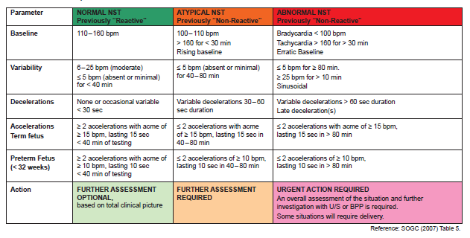
NST: Classification

Slide 22
Biophysical Profile (BPP)
Evaluation of fetal well being through the use of various reflex activities over 30 minutes :
Component | Criteria
1. Breathing movements | At least one episode continuing more than 30 seconds.
2. Movements | At least three body or limb movements.
3. Tone | An episode of active extension with return to flexion of a limb or trunk, or opening and closing of the hand.
4. Amniotic fluid volume* *AFV – In the presence of intact membranes and with a normal fetal renal tract, decreased amniotic fluid reflects decreased renal filtration due to redistribution of cardiac output away from the fetal kidneys in response to chronic hypoxia. (Chamberlain et al., 1984) | At least one cord- and limb-free fluid pocket which is 2 cm by 2 cm in two measurements at right angles.

Slide 23
BPP: Scoring
0 or 2 points for each (total of 8 points)
- 8 Reassuring
  - 6 Non Reassuring
  - 0 to 4 Imminent Delivery for fetal indications
Grade III placenta constitutes an abnormal biophysical assessment regardless of the overall score since it represents an aging placenta.
Oligohydramnios constitutes an abnormal biophysical assessment regardless of the overall score.

Slide 24
BPP: Components
1) Fetal Tone
Starts to function at 7.5 to 8.5 weeks of gestation.
  an episode of active extension with return to flexion of a limb or trunk or opening and closing of the hand
2) Fetal Movement
Starts to function at 9 weeks gestation
  at least 3 body or limb movements

Slide 25
BPP: Components
Fetal Breathing
Starts to function at approximately 20 – 21 weeks of gestation. Is abolished at a ph of 7.2.
  at least one episode continuing at least 30 seconds
Amniotic Fluid Volume
Decreased amniotic fluid can be the result of chronic hypoxia or can cause hypoxia.
A grade III placenta represents an aged placenta that may function inadequately.
  at least one cord and limb free fluid pocket which is 2 cm by 2 cm

Slide 26
Test Score Result | Interpretation | PNM within 1 week without intervention | Management
10/10 8/10 (normal fluid) 8/8 (NST not done) | Risk of fetal asphyxia extremely rare | 1/1000 | Intervention for obstetric and maternal factors
8/10 (abnormal fluid) | Probably chronic fetal compromise | 89/1000 | Determine that there is evidence of renal tract function and intact membranes. If so, delivery of the term fetus is indicated. In the preterm fetus <34 weeks, intensive surveillance may be preferred to maximize fetal maturity
6/10 (normal fluid) | Equivocal test, possible fetal asphyxia | Variable | Repeat test within 24 hour
6/10 (abnormal fluid) | Probably fetal asphyxia | 89/1000 | Delivery of the term fetus. In the preterm fetus <34 weeks, intensive surveillance may be preferred to maximize fetal maturity
4/10 | High probability of fetal asphyxia | 91/1000 | Deliver for fetal indications
2/10 | Fetal asphyxia almost certain | 125/1000 | Deliver for fetal indications
0/10 | Fetal asphyxia certain | 600/1000 | Deliver for fetal indications
Notes:
In the presence of intact membranes, functioning fetal kidneys, and unobstructed urinary tract, dec AF reflects decreased renal filtration due to redistribution of cardiac output away from the fetal kidneys in response to chronic hypoxia.

Slide 27
Doppler Flow Studies
Non invasive method of measuring uteroplacental blood flow in the umbilical arteries (assesses the resistance of blood vessels supplying the placenta)
Should not be used as a screening tool in healthy pregnancies
Indicated for assessment of the fetal placental circulation with suspected placental pathology

Slide 28
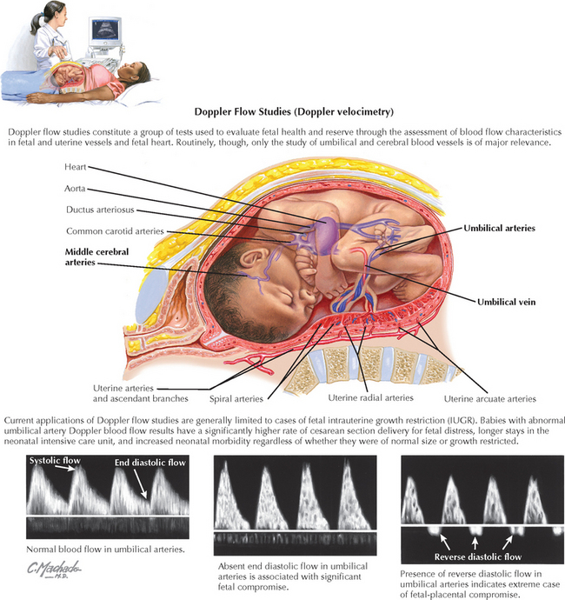
Doppler Flow Studies
Umbilical artery Doppler is used to identify evidence of fetal compromise to improve perinatal outcomes of high risk pregnancies at risk for placental insufficiency (Fetal growth restriction, preeclampsia) through timely intervention and delivery

Slide 29
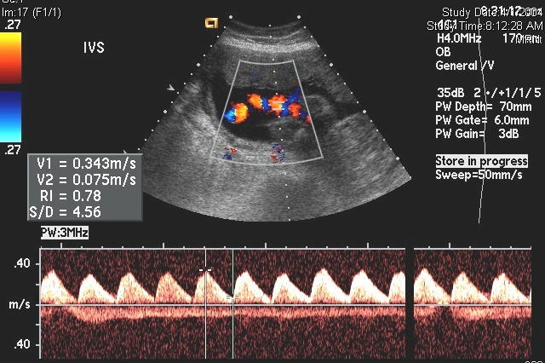
Umbilical Artery Doppler
Flow in the umbilical artery should be in the forward direction in normal circumstances.
End diastolic flow is present
Notes:
29
Fetal Health Surveillance - Instructor Notes

Slide 30
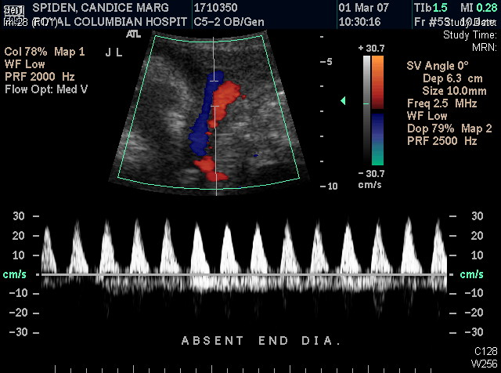
Absent End Diastolic Flow
AEDF can be normal in early pregnancy (up to 16 weeks). In mid to late pregnancy it usually occurs as a result of placental insufficiency.
If placental resistance increases, the diastolic flow may reduce, later becoming absent and finally reversed.
End diastolic flow is absent
Notes:
30
Fetal Health Surveillance - Instructor Notes

Slide 31
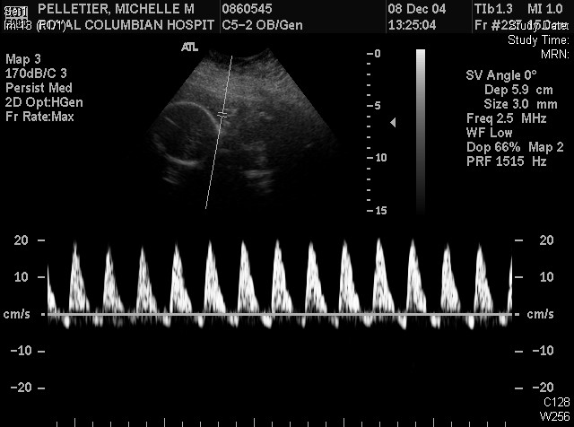
Reversed End Diastolic Flow
seen as a result of a significant increase in resistance to blood flow within the placenta and often represents a "tip of the iceberg" where there is a much larger underlying pathology
A word on redistribution…
End diastolic flow is reversed
Notes:
31
Fetal Health Surveillance - Instructor Notes

Slide 32
SOGC Recommendations
2023
Clinicians may defer delivery until 30–32 weeks gestation in cases of reversed end-diastolic flow in the umbilical arteries and to 32–34 weeks in cases of absent end-diastolic flow, so long as ductus venosus doppler and non-stress test are normal (strong, high).
Clinicians should administer a course of corticosteroids for fetal lung maturation prior to planned preterm delivery, followed by intravenous magnesium sulfate on the day of delivery for fetal neuroprotection (strong, moderate).
Caesarean delivery is generally indicated for placenta-mediated early-onset fetal growth restriction and major Doppler abnormalities in either the umbilical arteries (absent or reversed end-diastolic flow velocities) (strong, moderate).
When performing IOL for suspected IUGR, a mechanical method of cervical ripening should be preferred over a prostaglandin agent. Mechanical cervical ripening may be initially combined with low-dose oxytocin. Caesarean delivery should be performed if the fetal heart rate tracing becomes abnormal (strong, moderate).

Slide 33
Sources
The Canadian Perinatal Programs Coalition (2009)
Perinatal Services BC (2013)
SOGC (2023)
UBC CPD Fundamentals of Fetal Health Surveillance Online Manual (2023)

