Slide 1
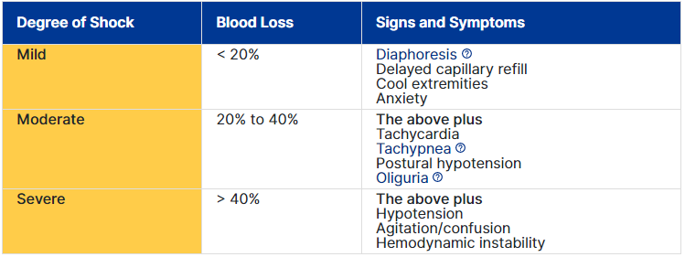
Postpartum hemorrhage (PPH)
Amount of blood loss required to cause hemodynamic instability will depend on the pre-existing condition of the woman.

Slide 2
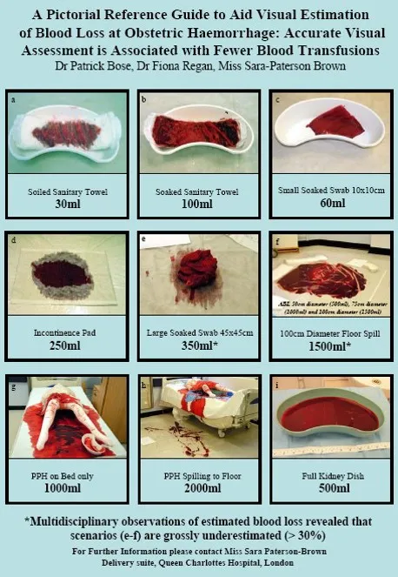

Slide 3
Postpartum hemorrhage - Etiology
4 « Ts »
Tone : uterine Atony, distended bladder (most common cause)
Trauma : uterine, cervical, vaginal injury, perineal tears, episiotomy
Tissue : retained placenta or clots
Thrombin : pre-existing or acquired Coagulopathy
It is important to know and understand the risk factors to be properly prepared and try to prevent PPH !

Slide 4
Postpartum hemorrhage – Risk factors
TONE
Over-distended uterus → polyhydramnios, multiple gestation, macrosomia
Uterine muscle exhaustion → rapid labor, prolonged labor, high parity, oxytocin use (saturated receptors), IOL
Intra-amniotic infection → fever, prolonged ROM
Functional/anatomic distortion of the uterus or bladder distension → fibroids, placenta previa, tocolytics (nitro)

Slide 5
Postpartum hemorrhage – Risk factors
TISSUE
Retained placenta or membranes → incomplete placenta at delivery, previous uterine surgery, high parity, abnormal placenta on U/S
Retained blood clots → atonic uterus
Manual removal of the placenta

Slide 6
Postpartum hemorrhage – Risk factors
TRAUMA
Lacerations of the cervix, vagina or perineum → precipitous delivery, assisted delivery
Extensions, lacerations at C/S
Uterine rupture → previous uterine surgery
Placenta accreta spectrum disorders → previa, prior C/S, prior myomectomy
Uterine inversion → high parity, fundal placenta
https://www.youtube.com/watch?v=OW0Yq2nWyuY

Slide 7
Postpartum hemorrhage – Risk factors
THROMBIN
Pre-existing states (Hemophilia, Von Willebrand disease) → Hx of hereditary coagulopathies, hx of liver disease, hx of other episodes of excessive bleeding
Acquired during pregnancy (Idiopathic thrombocytopenic purpura, thrombocytopenia with PET, DIC, gestational hypertension with adverse conditions, IUFD, abruptio) → bruising, elevated BP, fetal demise, fever, neutrophilia, antepartum hemorrhage
Therapeutic anti-coagulation → Hx of thrombotic disease, Factor V Leiden or other conditions

Slide 8

Postpartum hemorrhage - Etiology
4 « Ts »
Tone
Trauma
Tissue
Thrombin
Summary - Youtube

Slide 9
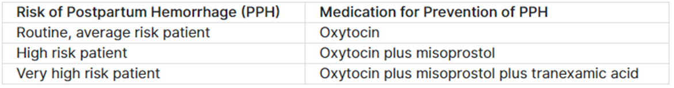
PPH - Prevention
Active management of third stage labor
Caregiver intervention to assist in the expulsion of the placenta by ↑ uterine contractions and to avoid PPH by preventing uterine atony.
3 components :
Administration of Uterotonic Agents : greatest impact on blood loss
Controlled cord traction (CCT) : ↓ need for manual removal of the placenta
Uterine Massage after delivery of the placenta

Slide 10
PPH - Prevention
OXYTOCIN
Preferred first line uterotonic
Stimulates muscle of upper uterine segment → compress blood vessels
IV : acts immediately / IM : 3-5 minutes
Side effects : N°/V°, headache, flushing
Usual dose : 10 units IM (if no IV access), 20-40un in NS (1L) at 150mL/hr (or wide open if active PPH. Maximum dose 100un in NS (1L)
*When there is 60un of Synto or more in a NS bag, ALWAYS by pump*

Slide 11
PPH - Treatment
MISOPROSTOL (CYTOTEC)
Causes vasoconstriction and enhanced contractility of the myometrium
Side effects : fever (most common with > 600mcg)
Usual dose : 400-800mcg PO. Alternate : 400mcg SL

Slide 12
PPH - Treatment
HEMABATE
Causes vasoconstriction and enhanced contractility of the myometrium
Use with EXTREME CAUTION if asthma or major cardiovascular/renal/hepatic dysfunction
Side effects : DIARRHEA, vomiting, fever
Usual dose : 250mcg IM q. 15 min. Maximum 8 doses (2mg)
Found in the fridge in the pharmacy

Slide 13
PPH - Treatment
ERGONOVINE (ERGOT)
Stimulates myometrium of the upper AND lower segments
IV : acts < 1 minute. IM : 2-5 minutes
CONTRAINDICATED in all hypertensive disorders of pregnancy
Side effects : N°/V°, hypertension
Usual dose : 0.2-0.25mg IM. May be repeated at 2h intervals
Found in the pharmacy fridge

Slide 14
PPH - Treatment
TRANEXAMIC ACID (CYKLOKAPRON)
Inhibits fibrinolysis
Usual dose : 1g IV over 10minutes
Can be repeated if : bleeding persists after 30 minutes or re-starts within 24 hours
Found in the ADC cart

Slide 15
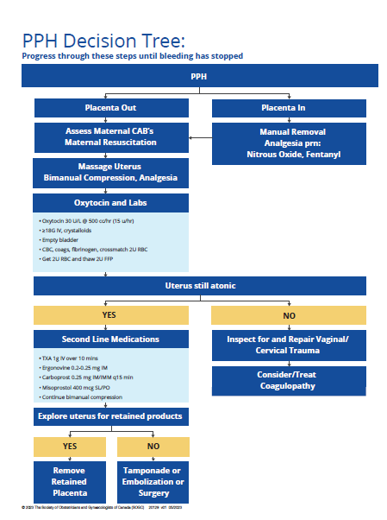
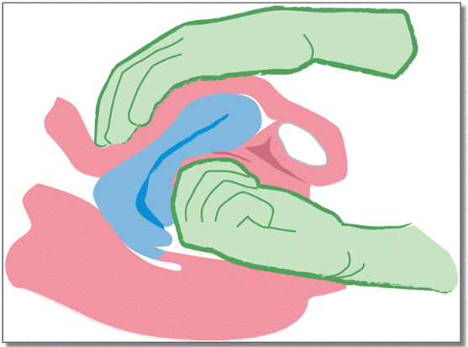
Consider 2nd IV at same time as blood tests
Bimanual massage/compression
This tamponade will ↓ further bleeding

Slide 16
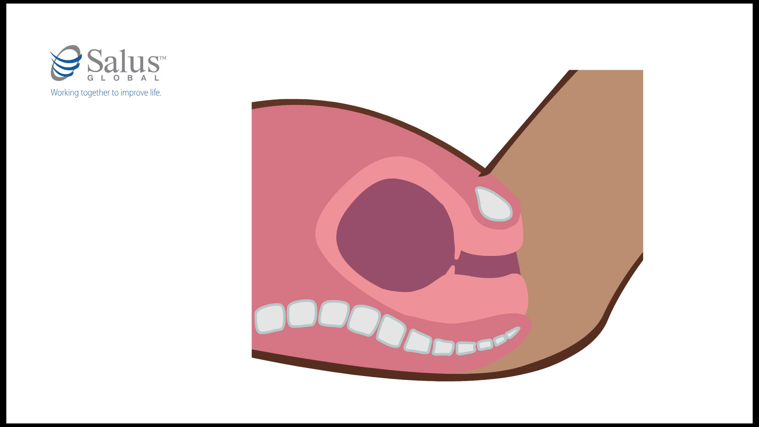
PPH management – Bakri balloon
Uterine balloon tamponade (Bakri balloon)
Effective method to temporarily stop bleeding
Reduces morbidity (blood loss, transfusion, embolization, hysterectomy, ICU admission
Safe for transport
May be used in combination with other interventions
Found in the PPH box

Slide 17
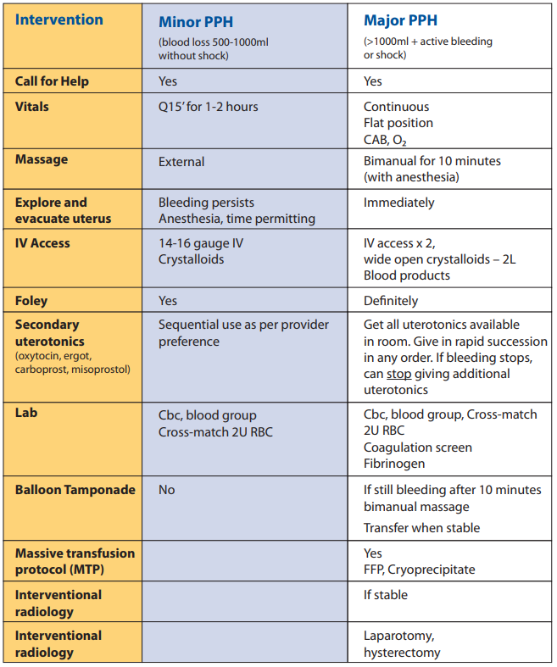

Slide 18
