Slide 1
Antenatal
Hypertensive Disorders
Antepartum Orientation
Day 1

Slide 2
Introduction
Hypertensive disorders are one of the leading causes of maternal death. They can be linked to newborn congenital malformations
Women with some hypertensive disorders, such as pre eclampsia (PET) occurring before 37 weeks gestation can be at increased risk of stillbirth, abruption, and spontaneous preterm rupture of membranes.
Although statistically the rates of PET are low (5-7%) the complications remain significant (over 70,000 maternal deaths and 500,000 fetal deaths worldwide).

Slide 3
Values
BP | normal | Moderate HTN | Severe HTN
Systolic | ≤ 135 | 140-160 | ≥160
diastolic | ≤ 85 | 90-110 | ≥110

Slide 4
Blood Pressure Assessment
Minimum rest period of 10 minutes prior to measuring BP
Sitting position with upper arm at heart level
*Appropriate size cuff (too small overestimates BP; too large underestimates BP)
Length of cuff 1.5 times arm circumference
Should NEVER be placed over clothing
If BP consistently higher in one arm, the arm with the higher values should be used for all BP measurements
MORE OB, 2024; SOGC, 2022

Slide 5
Blood Pressure Assessment:
Hypertension in Pregnancy
90 mmHg is the dBP level above which perinatal morbidity is increased
dBP is a better predictor of adverse pregnancy outcome than sBP
Severe HTN (Hypertensive crisis) should be defined as a sBP ≥160 mmHg or dBP ≥110 mmHg
For severe HTN, a repeat measurement should be confirmed in 15 minutes*
MORE OB, 2024; SOGC, 2022

Slide 6
Definitions
Chronic hypertension: Systolic BP ≥ 140 mmHg or Diastolic BP ≥ 90 mmHg diagnosed prior to pregnancy or before 20 weeks
Gestational hypertension: Systolic BP ≥ 140 mmHg or Diastolic BP ≥ 90 mmHg after 20 weeks gestation without proteinuria or systemic signs and symptoms
Severe hypertension: Systolic BP ≥ 160 mmHg or Diastolic BP ≥ 110 mmHg
Eclampsia: incidence of seizures in a patient with PET not associated with other health conditions

Slide 7
Definitions
Gestational HTN with proteinuria OR Gestational HTN with typical end-organ dysfunction with or without proteinuria
Gestational or Chronic HTN
PET
Proteinuria
Maternal organ or
Uteroplacental dysfunction
Preeclampsia & eclampsia - causes, symptoms, diagnosis, treatment, pathology
moreOB, 2024
Notes:
Definition of preeclampsia by SOGC is: Gestational HTN with proteinuria OR Gestational HTN with typical end-organ dysfunction with or without proteinuria

Slide 8
Definitions
Adverse conditions** consist of:
Maternal Symptoms | Maternal Signs of End-Organ dysfunction | Abnormal Maternal Lab Testing | Fetal morbidity
Persistent or new/unusual headache Visual disturbances Abdominal or right upper quadrant pain Severe N/V Hyperreflexia | Eclampsia Severe HTN Pulmonary edema Oliguria Chest pain/dyspnea Suspected placental abruption | ↑ serum creatinine ↑ AST, ALT, LDH (liver enzymes) Platelet count < 100 X 10^9/L Serum albumin < 20 g/L UPCR ≥ 0.03g/mmol (0.26g/g) | Oligohydramnios IUGR AEDF or REDF in umbilical artery Atypical/Abnormal FHR IUFD
Notes:
N.B. LDH (lactate dehydrogenase)- LDH is most often measured to check for tissue damage. The enzyme LDH is in many body tissues, especially the heart, liver, kidney, skeletal muscle, brain, blood cells, and lungs.
*24-hour urine collection is the gold standard for a diagnosis of proteinuria
A (UPCR) at a level ≥ 0.03g/mmol urinary creatinine in a random urine sample is suggestive of proteinuria, but < 0.03g/mmol rules out proteinuria

Slide 9
Hypertensive disorders 101: what causes PET?
The exact cause of PET is unknown. The most popular theory describes multi stages
Stage 1:
  Artery remodeling during the first half of pregnancy, leading to structural defects and placental ischemia
Stage 2:
  Systemic maternal disease (overt preeclampsia) resulting from inflammatory placental factors generated by poor placental functioning
https://www.youtube.com/watch?v=CRhGx8A7Dqg
Notes:
Delivery of the placenta is the only cure for preeclampsia.

Slide 10
Hypertensive disorders 101: who is at risk of PET?
Some risk factors include:
Previous PET
Anti phospholipid antibodies
Pre existing conditions (HTN, diabetes, renal disease, collagen vascular disease)
Obesity
Multiple pregnancy (twins)
Age above 40 or below 18
Family hx of PET
Black Ethnicity
1st pregnancy

Slide 11
Hypertensive Disorders 101: Morbidity and Mortality in PET
Maternal complications:
  Stroke
  Pulmonary edema
  Hepatic failure
  Jaundice
  Seizure (eclampsia)
  Placental Abruption
  Acute renal failure
  Cerebral hemorrhage
  Death
Of note: Women with chronic HTN will develop superimposed PET in 26% of cases

Slide 12
Hypertensive Disorders 101: Morbidity and Mortality in PET
Fetal complications:
  Oligohydramnios
  IUGR
  NICU admission
  Prematurity due to maternal indication for delivery
  Fetal death

Slide 13
Case Scenario:
Emmanuella is a 25 years old women admitted at 28weeks for PET. You take her VS. You get a BP reading of 160\110, HR: 89, R:24, O2: 98%.
In the chart, no history of hypertension was noted. Her BPs throughout her hospitalization were stable at about 130\85.
How do you proceed?

Slide 14
Nursing evaluation and management of hypertensive emergency
Patient has BP ≥ 160/110 mmHg . Assessment should include:
Level of sedation
BP, HR, RR, O2 Sat
Symptoms of PET: severe headache, visual disturbances, RUQ abdominal pain or epigastric pain, nausea/vomiting
Signs of PET: oliguria, proteinuria (0.26g/g), hyperreflexia, O2 sat ˂ 95%
FHR
Repeat BP in 15 minutes

Slide 15
Nursing evaluation and management of hypertensive emergency
2nd BP: ≥ 160/110 mmHg = Hypertensive emergency
Interventions:
Advise Obstetrics medical team immediately
Initiate collective order for Oral Nifedipine if MD not available within 15 minutes
Follow Obstetric emergency treatment algorithm
Consider/prepare for possible administration of MgSO4

Slide 16
Hypertensive Emergency:
Communication Tree
Antepartum | Term patient / Postpartum
Call the senior OB resident or Maternal Fetal Medicine fellow If not available within 15 minutes, call the in-house OB attending physician | OB junior resident If not available within 15 minutes, call senior OB resident If not available within 15 minutes, call in-house OB physician If not available within 15 minutes, call patient’s staff doctor

Slide 17
Hypertensive Emergency:
Considerations
A drastic fall in a pregnant woman’s BP may compromise utero-placental perfusion and fetal well-being. Target BP range should < 160 /110
Labetalol and Hydralazine are both considered high-alert medications Ensure close maternal and fetal monitoring One to one nursing until the BP has stabilized
Labetalol IV and Hydrazaline IV may only be administered by a physician.
Closely monitor the patient’s BP once it has been stabilized

Slide 18
Hypertensive Emergency:
Collective Order - Nifedipine
2 readings of BP ≥ 160/110mmHg → Call appropriate physician
Assess contraindications:
Previous allergy to Nifedipine
Heart condition (heart failure, myocardial infarction, cardiomyopathy, etc)
Hepatic insufficiency
Aorctic stenosis
Intestinal obstruction

Slide 19
Hypertensive Emergency:
Collective Order - Nifedipine
If no contraindication, and MD not available within 15 minutes, administer Nifedipine:
  Nifedipine immediate-release 5mg PO x1 STAT
  Do NOT administer a second dose until MD has assessed patient
Continue assessment: repeat BP after 20 minutes. If BP remains elevated and physician has not responded, call attending OB. Repeat BP q 20 minutes until patient has been assessed by MD
Document
    Note: collective order can only be initiated by a RN, not a LPN or a CEPI

Slide 20
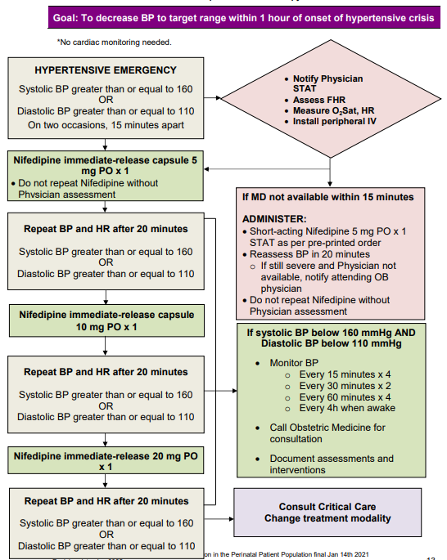
NIFEDIPINE PO

Slide 21
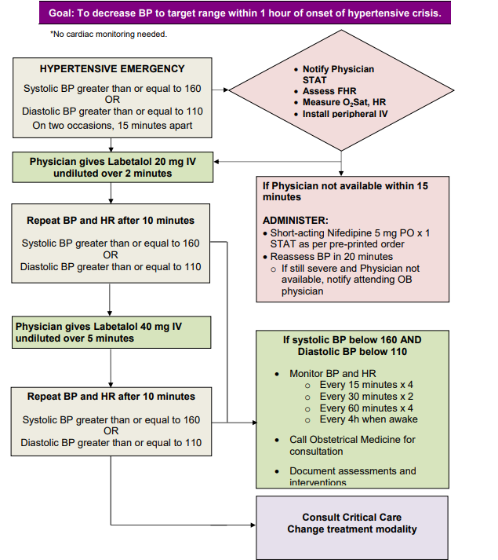
LABETALOL IV

Slide 22
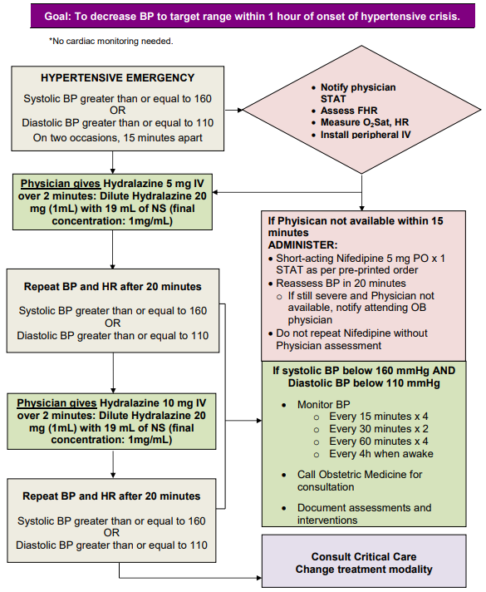
HYDRALAZINE IV

Slide 23
HTN Assessment

Slide 24
Assessment
Visual disturbances (reflects occipital cortical ischemia)
Persistent headache (reflects cerebral ischemia)
Epigastric or right upper quadrant pain and/or N/V (associated to hepatic injury/attainment)
Dyspnea and/or chest pain (may indicate non-cardiogenic pulmonary edema)
High blood pressure
PET labs + protenuria

Slide 25
Preeclampsia
by organ system
Cardiovascular
    Intravascular volume reduced and edema can occur
    D/t vasoconstriction and “capillary leaking” – facial edema more common in women with preeclampsia
    Assess for HTN

Slide 26
Preeclampsia
by organ system
  Pulmonary Edema
  Sign of severe preeclampsia
  D/t excessive elevation in pulmonary hydrostatic pressure compared with plasma oncotic pressure
  Iatrogenic (induced by Tx) volume overload
  Assess for:
    Tightness in chest or discomfort
    Shortness of breath
    Shallow, rapid respirations
    Crackles auscultated
    Coughing, with or without frothy sputum
    Tachycardia >120 bpm
    Low O2 saturation (less than 92%)

Slide 27
Preeclampsia
by organ system
Renal
    Kidney organ most likely to manifest endothelial injury related to preeclampsia
    Assess for
      Elevated creatinine (greater than 90 umol/L)
      Proteinuria

Slide 28
Preeclampsia and
Proteinuria
Proteinuria indicates glomerular dysfunction
≥ 300 mg/day (0.3 g/day) in a 24 hour urine collection
≥ 0.03g/mmol (0.26g/g) in a random protein to creatinine ratio (urinary protein/CR ratio)
Proteinuria strongly suspected when urinary dipstick proteinuria is ≥ 2+
  N.B. Dipstick not reliable, significant false positive and false negative results!
28
28

Slide 29
Preeclampsia
by organ system
Hematologic
    D/t microangiopathic endothelial injury and activation
    Assess for:
      Thrombocytopenia
      Platelet consumption
        **Platelet count < 100 X 10ˆ9/L upstages preeclampsia from mild to severe
Notes:
***Microangiopathy: A disease of the capillaries (very small blood vessels), in which the capillary walls become so thick and weak that they bleed, leak protein, and slow the flow of blood.

Slide 30
Preeclampsia
by organ system
Hepatic
    D/t reduced hepatic (liver) blood flow → ischemia/hepatic swelling/injury
    Assess for
      Epigastric pain - cardinal symptom of severe preeclampsia
      Usually experienced as a severe constant pain
      Nausea and vomiting

Slide 31
Preeclampsia
by organ system
CNS
    D/t vasospasm of cerebral vasculature in response to severe HTN
    Assess for:
      Headache (may be temporal, frontal, occipital or diffuse)
      Usually throbbing/pounding, may be piercing
      Persists despite administration of analgesics
    Seizure signifies change in diagnosis to eclampsia → cerebral edema and ischemic/hemorrhagic changes may be observed
    Stroke most serious complication of severe preeclampsia/eclampsia, but is rare

Slide 32
Preeclampsia
by organ system
Eyes
  Visual symptoms d/t in part, constriction of retinal arteries
    Assess for
      Blurred vision (scotoma = blurry patches), flashing light or sparks, dark areas or gaps in visual field, blindness in 1 eye

Slide 33
References
MoreOB (2017), Hypertensive Disorders in Pregnancy Retrieved from: https://secure.moreob.com/en?t=/contentManager/selectCatalog&displayMode=1&ParentID=1205698412125&intro=1&startRow=0&active=no
Staff, A. C. (2019). The two-stage placental model of preeclampsia: An update. Journal of Reproductive Immunology, 134–135, 1–10. https://doi.org/10.1016/j.jri.2019.07.004
Preeclampsia: clinical features and diagnosis. (2025, March).UpToDate. https://www.uptodate.com/contents/preeclampsia-clinical-features-and-diagnosis#H14937496

