Slide 1
Antepartum Orientation
Day 1
Antepartum Pathologies and
Standards of Management
Elisabeth Chailloux
slides adapted from
Ruth-Lynn Fortuné,
Malisa Kongham & Luisa Ciofani

Slide 2
Learning Objectives
Able to
  Understand specific terminology to antepartum
  Recognize the physiologic changes during the pregnancy
  Differentiate the antepartum pathologies and identify their complications’ signs and symptoms and the management care
  Understand the routine on antepartum
  Able to manage antepartum bed rest patient

Slide 3
Terminology in Obstetrics
It is important for all health care professionals to use the same language and standards when referring to patients in order to promote safe patient care

Slide 4
Terminology in Obstetrics
Parturient: a woman in labor
Antepartum/Prenatal stage: Time between conception and the onset of labor
Intrapartum stage: Time from onset of labor and the birth of the infant and placenta
Postpartum stage: Time from birth until the woman’s body returns to a non-pregnant condition

Slide 5
Terminology in Obstetrics
Nulligravida: A woman who has never been pregnant
Primigravida: A woman pregnant for the first time
Multigravida: A woman who is pregnant for her second or any subsequent pregnancy
* Grand multip.: 4 or more pregnancies
G (Gravida) | Number of times a woman has conceived, including any current pregnancy
P (Para) | Number of times a woman has given birth after 20 weeks of pregnancy
T (Term) | Number of times a woman has carried a pregnancy to at least 37 weeks and delivered
P (Preterm) | Number of times a woman has delivered before 37 weeks but after 20 weeks gestation
A (Abortions) | Number of times a woman has lost a pregnancy, whether it was elective or spontaneous (miscarriage) before 20 weeks
L (Living children) | Number of living children to this day

Slide 6
Terminology in Obstetrics - Quiz
Lucy is pregnant with her sixth child. One pregnancy resulted in a loss at 24 weeks. She had 1 baby born at 38 weeks and 2 babies born at 40 weeks. She also had an early miscarriage at 6 weeks with her first pregnancy.
Determine her GPAL obstetrical history.

Slide 7
Terminology in Obstetrics
EDC: Estimated date of confinement
GA: Gestational age
LMP: Last menstrual period
Cx: Cervix
Ctx: Contractions
VE:Vaginal exam
FHR: Fetal heart rate
AFI: Amniotic Fluid Index
BPP: Biophysical Profile
CEFM: Continuous Electronic
Fetal Monitoring
NST: Non-Stress Test
FM: Fetal Movement

Slide 8
Terminology in Obstetrics
Perinatal Loss
  IUFD : Intra Uterine Fetal Death/Demise
  Stillbirth : An infant born dead ≥ 20 weeks GA or ≥ 500g
  Abortus : An infant born dead < 20 weeks GA or < 500g

Slide 9
Estimated Date of Confinement (EDC)
In the 19th century, one of the terms used to describe the experience of going into labor and delivery was “confinement”. Women delivered and recovered in the privacy of their homes.
Estimated date of birth
  Calculated based on first ultrasound (<20 weeks) or LMP

Slide 10
Calendar of Pregnancy
Average length of pregnancy
10 months = 40 weeks = 280 days
Begins from the first day of the LMP and ends the day of birth
Conception/fertilization
20 wks
37 wks
40 wks
42 wks
2 weeks post conception
LMP
Abortus < 20 completed wks
or < 500 g
Preterm < 37
completed wks
Term 37-42 completed wks
Post-Term > 41.3 wks

Slide 11
Calendar of Pregnancy
40 wks
10 wks
20 wks
24 wks
42 wks
28 wks
34 wks
Fertilization
37wks
8 wks
LMP
Embryo
Foetus
Viability:
GA generally accepted as having the capability of living (25 weeks)
Gray zone 23-24
Age of Viability
Extreme Prematurity
Very Preterm infant
Late preterm infant
Term
Post-term

Slide 12
Physiological Changes During Pregnancy
https://www.youtube.com/watch?v=A0sp7I9rlz8&t=2s

Slide 13
High Risk AP Population:
Pathologies and Management
Preterm Prelabor Rupture of Membrane (PPROM)
Bulging/
Hourglassing
Membranes
Preterm Labor
(PTL)
Per Vaginal Bleeding (PVB)
Placental Abroption
Short Cx
Funneling Cx
Placenta Previa
Pain Management
Uncontrolled Diabetes or PET
Multiple Gestation Pregnancy
Other…

Slide 14

PRETERM LABOR (PTL)
Labor occurring prior to the completion of 37 weeks of gestation
*** 4 ctx in 20min or 8 ctx in 60min

Slide 15
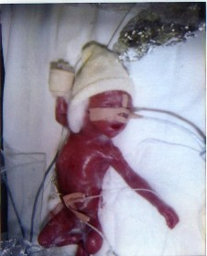
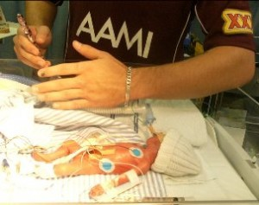
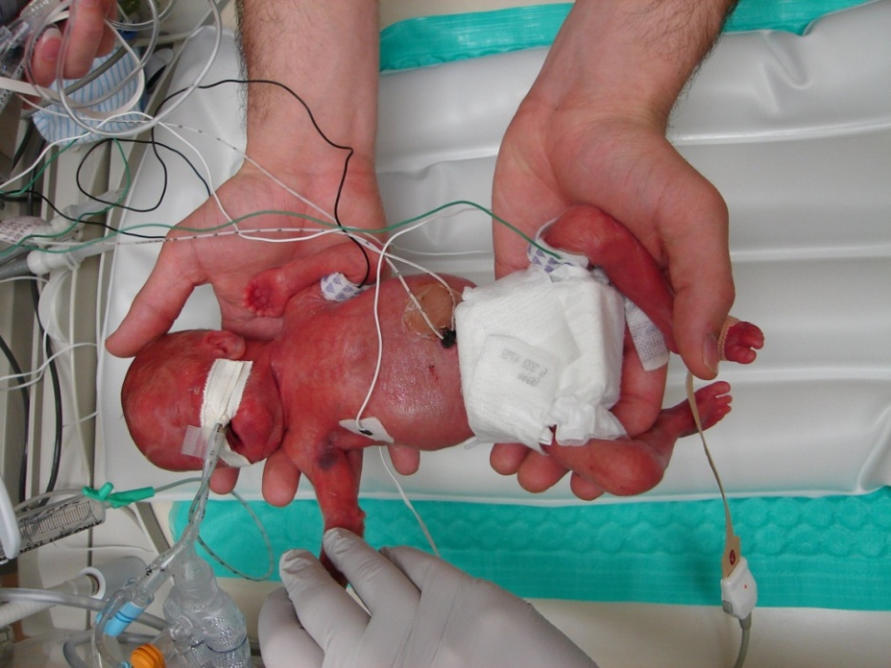
PRETERM LABOR (PTL)
24 weeks
22 2/7 weeks

Slide 16
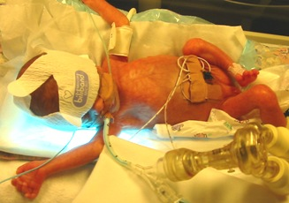
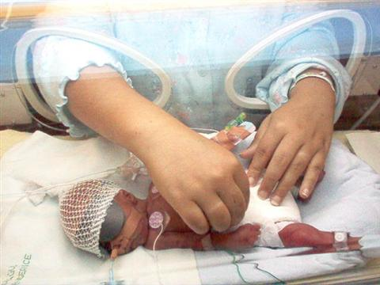
PRETERM LABOR (PTL)
26 weeks
27 weeks

Slide 17
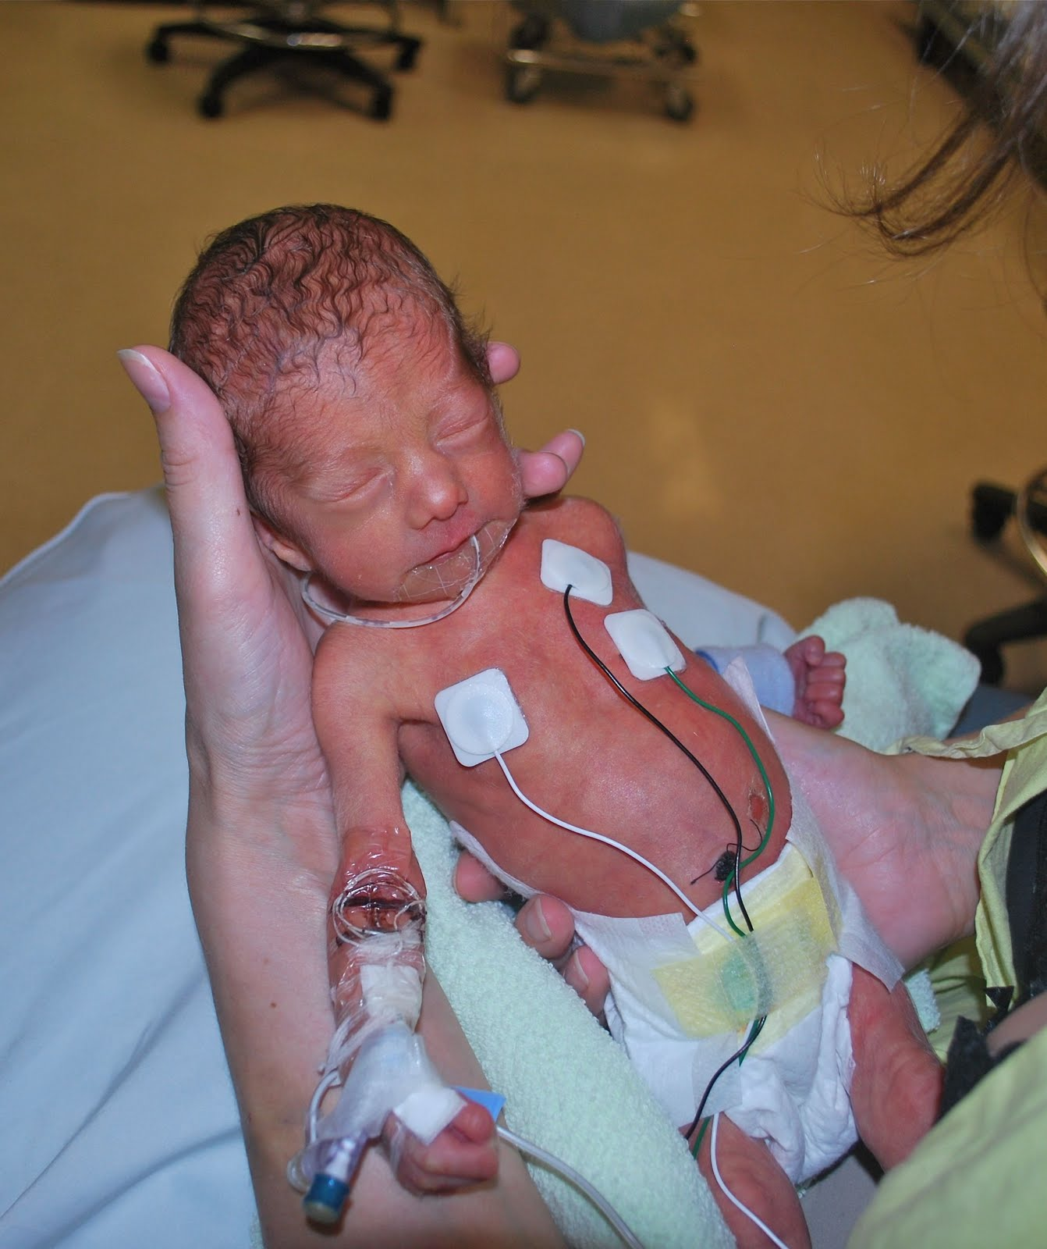
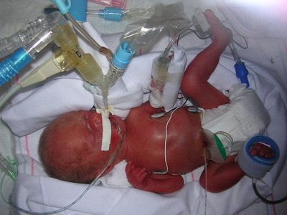
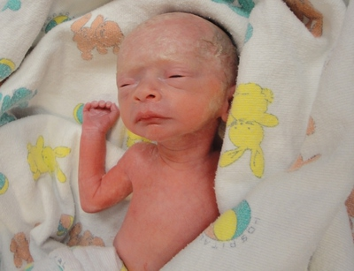
PRETERM LABOR (PTL)
29-30 weeks
31 weeks

Slide 18
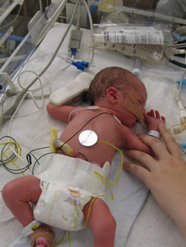
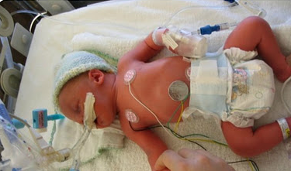
PRETERM LABOR (PTL)
34 weeks
33 weeks

Slide 19
PTL: Risk Factors
Reproductive Hx | Previous spontaneous Pre-term birth | Use of Reproductive Technologies
Current Obs Hx | PPROM | Antepartum Bleeding | Placenta Previa / Abroption | Cervical incompetence | Polyhydramnios | Uterine anomaly / Fibroids / Cervical Neoplasia
Infection | Chorioamnionitis | Bacteriuria | Peridodontal disease (Gum Disease) | Bacterial Vaginosis with Hx of pre-term birth | Malaria | Any Systemic / Genito-urinary Infection
Maternal Factors | Lifestyle Factors | Poor Nutrition | Maternal Age <16 or >40 | Inadequate Prenatal Care | HTN / Diabetes | Anemia
Fetal Factors | Fetal anomalies (e.g. Trisomy, Hydrops, etc.) | Mutliple gestation
Notes:
Peridodontal disease (Gum Disease) : Bacterial spreading and Inflammatory products dissemination

Slide 20
PTL: Warning Signs
Menstrual cramp-like pain or tightening (like being bloated)
Uterine contractions (in irregular or regular pattern) – By palpation*** May not always pick up on the monitor
Dull lower back pain
Pelvic / Lower abdomen pressure
Increase / change in vaginal discharge
Bloody show / Bleeding
Spontaneous rupture of membrane (ROM)
Cervical changes (VE)
Nausea / Vomitting, Diarrhea
Most pt expect ctx to feel like the terrible pain they see in movies, and will NOT report tightenings necessarily.
TEACHING IS IMPORTANT!

Slide 21
PTL: Warning Signs
*** Patient does NOT need to be fully dilated to deliver a premature baby ***
If a patient reports ANY changes from usual, do a FULL assessment and Notify MD

Slide 22
PTL: Warning Signs - Exercise
Mrs. G is 28 weeks pregnant, she admitted x 2days for PTL, she reports pink spotting when she wiped x1 this morning
What do you do?

Slide 23
What if she is really contracting???

Slide 24
PTL: Interventions
CFHM until MD assessment
IV Bolus / Hydration
Bedrest / Left lateral position
Update MD of any change
Pain management
Medication as per Rx (e.g. adalat, Abx, Beta, etc)
Notes:
Adalat is a calcium channel blocker inhibits the transmembrane influx of calcium, leading to a reduction in intracellular calcium therefore contractility. Can usually gain 3-27 days…but has no impact on the mean GA of delivery

Slide 25
PTL:
Routine Care

Slide 26
PTL: Routine Tests
Chlamydia-neiss. Gono PCR – Vaginal
Vaginal bacterial culture
Strep B – Vaginal-rectal
Urinanalysis + Urine bacterial culture
Fetal Fibronectin Test (fFN)
Ultrasound
    Growth
    AFI/BPP
    Cervical length (Less than 25mm is associated with PTL)
OACIS Folder
Notes:
fFN is a glycoprotein that has been identified in the AF, placenta and choriodecidual interface. It is belived to act as a cellular glue to help maintain placental-uterine adhesion throughout pregnancy, which progressively is reduced as term approaches to allow placental seperation. If it is present in the vaginal fluid, it is thought to create local inflammation of the placental-decidual interface.

Slide 27
PTL: Routine Management
Corticosteroids Therapy (Accelerate fetal pulmonary maturity)
  Betamethasone 12mg IM q24hrs OR
  Dexamethasone 6mg IM q12hrs
      Gestation > 23*-24wks but < 34.0wks
      Full benefits (course completed) 24h post 2nd dose
      Incomplete course is still beneficial
  May cause transient hyperglycemia (12h – 5 days) in the mother AND hypoglycemia in baby if born within the week after administration
  Booster : Beta 12mg IM x1 ONLY if:
    At risk of delivery in the next 7 days
    More than 2 wks have passed since initial course
    GA at initial course was < 28wks
    Avoid repeat course or more than 2 courses
  Corticosteroids are associated with increased risk of investigation for neurocognitive disorders (late pre-term) and increased risk of mental or behavioral disorders (term) (low certainty; limited evidence)

Slide 28
PTL: Routine Management
Tocolysis
  Process of administering a drug to inhibit uterine contractions of labour
    Nifedipine (Adalat)
    Indomethacin (Indocid)
Often stops contractions temporarily, but does not remove the underlying cause of PTL (which is why we don’t use it indefinitely)
  Indications:
    Gestation > 22-24wks but < 35wks
    A live fetus without signs of severe distress or congenital anomalies incompatible with life (e.g. hydrops)
    To complete full course of Beta

Slide 29
PTL: Tocolytics
Nifedipine (Adalat)
  Loading dose : 20mg – 10mg – 10mg q20min
  Maintenance dose : 20mg PO q 8hrs until Beta complete
  Monitor BP before administering each dose
  Side effects : Dizziness, Lightheadedness, H/a, Flushing, Nausea
  Indomethacin (Indocid)
  Loading dose 100mg PR suppository
  Maintenance dose : 25-50mg PR q 6hrs x 48hrs
  Side effects : Ulcers, Intestinal bleeding
Potential fetal complications of Indomethacin:
  Should not be used after 32 weeks’ gestation
  Increased sensitivity of the ductus arteriosis to premature closure
  Reduced fetal urine production causing Oligohydramnios
  Indomethacin should not be used for more than 48 hours without assessment of amniotic fluid volume

Slide 30
PTL: Tocolysis - Contraindications
Severe PET / HELLP
Other maternal indication for delivery
Chorioamnionitis
GA > 34.1 wks
Imminent delivery
IUFD or severe fetal anomalies
Abnormal FHR
Antepartum hemorrhage (Abroption)

Slide 31
PTL: Routine Management
Magnesium Sulfate
  Used for neurological protection of the fetus
    23*-24 wks < GA < 34 wks of gestation
    Risk of delivery within 24hrs
    Decrease risk of cerebral palsy and severe motor dysfunction
Given in the Birthing Center, but loading dose can be started in Antepartum
  Same Dosage and Monitoring as for PET (4g Bolus, then 1g/h)
  VS and LOC q 15min x 1h, then q 1h
  Pulmonary auscultation q 4h
  Reflexes q 2h
  CEFM
  Foley NOT necessary, but In/Outs MUST be monitored

Slide 32
PTL: Routine Management
Magnesium Sulfate
  Signs of TOXICITY
    Altered level of consciousness
    Absence of deep tendon reflexes
    Respiration rate less than or equal to 12 breaths/minute
    Oxygen saturation less than 92%
    Urinary output less than 15mL/h for 2 h
Antidote
Calcium gluconate 10%
DOSE: 1 g (10 mL) of 10 % calcium gluconate IV push over 3 minutes by the physician
Resuscitation equipment readily available

Slide 33
PRETERM PRELABOR RUPTURE OF MEMBRANE (PPROM)
Term PROM (≥ 37 weeks)
  8% of all pregnancy
  60-70% women will go into spontaneous labor within 24h
  95% within 72h
Preterm PROM, PPROM (<37 weeks)
  1 to 3% of all pregnancy
  50% women will go into spontaneous labor within 1 week
  1/3 women will develop serious infections, such as chorioamnionitis or endometritis, which may be result in septicemia

Slide 34
PPROM: Risk Factors
Idiopatic (unknown cause)
Amniocentesis
Cervical insufficiency / Cerclage
Cervical Conization, laser Conization, loop electrosurgical excision (LEEP) procedure
PPROM / PTL in previous pregnancy
Chronic abruptio placenta / Vaginal bleeding in pregnancy
Uterine distension (Multiple gestation, polyhydramnios)
Cigarette smoking
Sexually transmitted infection
Bacterial vaginosis
Low social economic status

Slide 35
PPROM: Complications
Preterm labor and delivery
  Complications of a preterm delivery
Fetal \ neonatal infection
  May lead to chorioamnionitis → severe intraventricular hemorrhage, severe NEC & death
Maternal infection
Umbilical cord compression \ prolapsed
Associated with increased cesarean rate
Oligohydramnios
  Pulmonary hypoplasia
  Fetal deformity

Slide 36
PTL: Warning Signs - Exercise
Mrs. G is 28 weeks pregnant, she admitted x 2days for PPROM, she reports constant suprapubic pressure
What do you do?

Slide 37
PTL: Warning Signs - Exercise
Mrs. G is 28 weeks pregnant, she admitted x 2days for PPROM, she reports suprapubic pressure
Assessments:
-Abdominal palpation for uterine activity
-Any ctx? Tightening? Other Discomfort (R/o Ligament pain)?
-Any PVB since?
-FM?
-VS (if not done recently)
-Obstetrical Hx?
-What is the likelihood that she will deliver preterm?
Interventions:
-FHM if not already on the monitor
-F/u with MD based on assessment and urgency
-Provide reassurance / comfort

Slide 38
PROM:
Routine Care

Slide 39
PPROM: Routine Tests
3 clinical signs on sterile speculum examination:
    Pooling : visual pooling of clear fluid in the posterior fornix of the vagina or leakage of fluid from the cervical os
    Nitrazine: alkaline pH of the cervicovaginal discharge, discharge turns yellow nitrazine paper to blue (nitrazine test)
    Ferning: microscopic ferning of a sample of fluid from the posterior Fornix
  Amnisure
    99% accurate
    No speculum required
    EXPENSIVE
Diminished AFI by ultrasound CANNOT alone confirm the diagnosis, but may help to suggest it in the appropriate clinical setting.

Slide 40

PPROM: Routine Tests
Nitrazine paper: pH testing of fluid
  This test is non-specific
  Positive : Nitrazine paper changes from yellow → green when in contact with a pH above 6.5
  Amniotic fluid pH is 7.1 to 7.3.
  **False positive results can occur d/t presence of blood, vaginal infections, alkaline urine and semen**
Can be used on a peripad or on entrance of vagina by RN

Slide 41
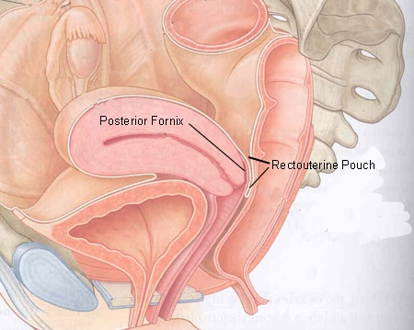
PPROM: Routine Tests

Slide 42
PPROM: Routine Tests

Slide 43
PPROM: Routine Tests
    CBC, C-Reactive Protein (CRP) q 4days
    Chlamydia-neiss.gono PCR –Vaginal (on admission)
    Vaginal bacterial culture (on admission)
    GBS – Vagina-rectal (on admission)
    Urinanalysis + Urine bacteria culture (on admission)
    OBS Ultrasound
        AFI / BPP
        Growth
    OACIS Folder

Slide 44
PPROM: Assessment
Visual assessment of PVL at least twice per shift (i.e. q4h)
      Quantity
      Quality (color, odor)
Assessment of maternal and fetal well-being (FHR)
Avoid VE (Speculum is a better option)
Teaching :
      Associated signs of PTL
      Pt to notify RN if any change

Slide 45
PPROM: Management 34-36 wks
Avoid digital cervical exam
Ultrasound assessment of fetal Position, cervical status and AFI
Antibiotics for GBS prophylaxis, if indicated
Assess for infection (same cultures as PTL)
Ensure ongoing surveillance for infection (maternal HR and T°, FHR, presence of uterine tenderness, WBC and CRP)
Induction of labor with oxytocin to reduce the risk of chorioamnionitis
Inform women of the benefits and risks of induction of labor compared with expectant management
If Chorioamnionitis is suspected, administer appropriate antibiotics and deliver.

Slide 46
PPROM: Management < 34 wks
Recommended antibiotic therapy
    Ampicillin 2g q 6 h IV, for 48 hours, followed by amoxicillin 250 mg PO q 8 h for 5 days.
    Erythromycin 250 mg q 6 h IV, for 48 hours, followed by Erythromycin 250 mg q 6h PO for 5 days.
Betamethasone
MgSO4 (if indicated)
Bedrest / Trendelenburg
    Set up the room (bedpans)
    Pt can get baby wipes to ensure perineal hygiene
    Teds stockings
    Waffle mattress if long term

Slide 47
Chorioamniotis
Inflammation of membranes (amnion and chorion) due to a bacterial infection
Intrauterine infection
Signs & Symptoms
  Fever (T > 38.1)
  Foul smell, purulent AF
  Maternal / Fetal Tachycardia
  Uterine tenderness
The fetal membranes consist of two parts:
The outer membrane is the chorion. It is closest to the mother and physically supports the much thinner amnion.
The inner membrane is the amnion. It is in direct contact with the amniotic fluid, which surrounds the fetus.

Slide 48
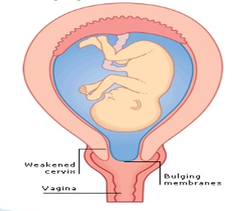
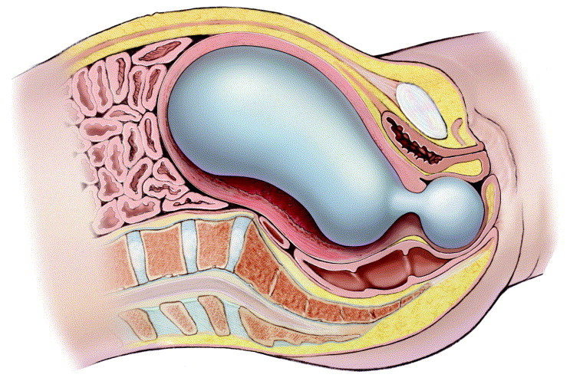
Other Diagnoses related to membranes
Bulging membranes
Hourglass membranes

Slide 49
PPROM: Exercise
Your patient is 31 weeks pregnant and is diagnosed with PPROM today. What would you expect the management for this patient to be?
Management?
Treatment?
Care?

Slide 50
PPROM: Exercise
Your patient is 31 weeks pregnant and is diagnosed with PPROM today. What would you expect the management for this patient to be?
-Expectant management (prolonging pregnancy as long as safely possible) vs induction to improve neonatal outcome?
-Abx
-CFHM and close monitoring for S&Sx of PTL until stable
-Beta
-MgSO4, if indicated
-NICU consult
-Bedrest

Slide 51
Amniotic Fluid Index (AFI)
Oligohydramnios
Polyhydramnios

Slide 52
Amniotic Fluid Index (AFI)
Measured in cm
Evaluation of the quantity of amniotic fluid by summing the deepest vertical pocket of fluid in the four quadrants of the uterus
    < 2 Severe Oligohydramnios
    2 - 3 Moderate Oligohydramnios
    4 - 5 Mild Oligohydramnios
    5 to 8 Borderline
    > 8 Normal
    > 19 Polyhydramnios

Slide 53
Oligohydramnios
Causes
      Fetal urinary tract anomalies,
      PPROM / PROM
      Placental insuffiency
Complication: chorioamnionitis (21-74%)
      Bronchopulmonary dysplasia
      Neurologic complications
      Pulmonary hypoplasia
      Respiratory failure
  Routine Care
    Bedrest
The earlier chorioamnionitis occurs, the greater the fetal risk

Slide 54
Polyhydramnios
Causes
      Twin gestation with twin-to-twin transfusion
      Esophageal atresia
      CNS abnormalities and neuromuscular diseases that cause swallowing dysfunction
      Congenital cardiac-rhythm anomalies associated with hydrops, fetal-to-maternal haemorrhage, and parvovirus infection (TORCH)
      Poorly controlled maternal diabetes mellitus (Oligohydramnios may also be seen if severe vascular disease is present)
      Chromosomal abnormalities, most commonly trisomy 21, followed by trisomy 18 and trisomy 13
  Complication: PTL
      secondary to overdistention of the uterus.
Notes:
Esophageal atresia (or Oesophageal atresia) is a congenital medical condition (birth defect) which affects the alimentary tract. It causes the esophagus to end in a blind-ended pouch rather than connecting normally to the stomach

Slide 55
Polyhydramnios
Management
      Schedule weekly or twice weekly perinatal visits and cervical examinations
      Place patients on bed rest to decrease the likelihood of preterm labor
      Perform serial ultrasonography to determine the AFI and document fetal growth
      Perform an amnioreduction

Slide 56
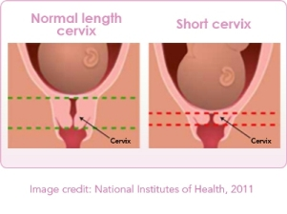
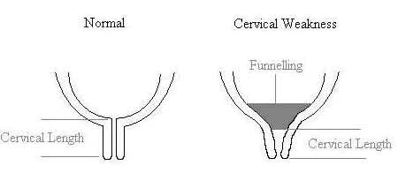
Cervical Issues
Incompetent Cervix
  Unusually weak / shortens during pregnancy WITHOUT ctx
  Measured by ultrasound (< 25mm is associated with PTL)
  Can lead to PTL and/or pregnancy loss
Funnelling Cervix
  Cervical canal assumes a cone-like shape
  Associated with PTL

Slide 57
Cervical Issues
Management
      Bedrest / Trendelenburg
      Frequent ultrasound for cervical length
      Frequent assessment for PTL

Slide 58
Cervical Issues - Exercise
What length of cervix (i.e. less than X mm) is associated with increased risk of PTL?

Slide 59
Placental Issues
Placenta Previa : Implantation of the placenta in the lower uterine segment near or over the internal cervical os.
  Placenta previa: Placenta is located over the internal os of the cervix
  Marginal previa: Placenta lies within 2 cm of the internal os
  Low-lying placenta: Placenta lies 2 cm to 3 cm from the internal os and does not carry any significant increased risk of maternal hemorrhage

Slide 60
Placental Issues - Previa

Slide 61
Placental Issues - Previa
Signs & Symptoms
  Painless, bright red vaginal bleeding
Risk Factors
  Previous placenta previa
  Previous caesarian birth or uterine surgery (including myomectomy and D&C)
  Multiple gestation (twins, triplets)
  Multiparity
  Closely spaced pregnancies (< 12 months)
  Advanced maternal age (> 35 years)
  African or Asian ethnicity
  Smoking
  Cocaine use

Slide 62
Placenta Previa - Management
Assess for Hemorrhage
    PVB – Quantity / Quality
    VS
    IV access – Bolus (if active bleeding)
    CBC, Coag (+Fibrinogen), X-Match q 96h
    Routine ultrasounds
      For BPP
      Growth
    Bedrest
    OACIS profile
Assess for Fetal Distress
  CFHM
  Ultrasound, if appropriate
  Start MgSO4, if indicated
CALL FOR HELP!!
If active bleeding or If fetal distress

Slide 63
Placenta Previa - Exercise
You are caring for a patient with placenta previa. The resident is doing his rounds. He asks you to come assist him with the vaginal exam.
What do you do?

Slide 64
Placental Issues
Placenta Accreta \ Increta \ Percreta
Placenta Accreta | Placenta Increta | Placenta Percreta
Placenta attaches to the superficial layer of the uterine myometrium (75%) | Placenta invade deeply into the uterine myometrium (15%) | Placenta penetrates through the uterine myometrium and attaches to another organ such as the bladder (5%)

Slide 65
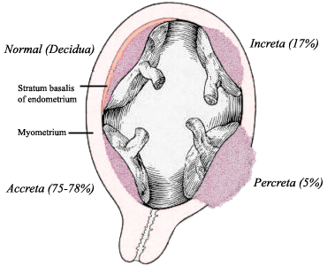
Placental Issues - Implentation
Causes
Unknown
Can be related to
  Placenta previa
  Previous c/s or other uterine sx (D&C)
Interventions
D&C
Hysterectomy

Slide 66
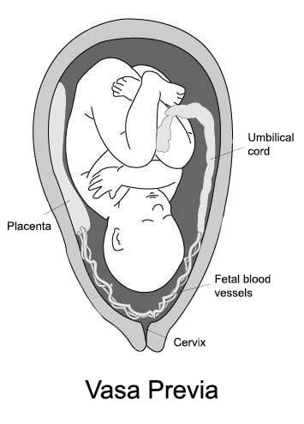
Placental Issues
Vasa Previa
  Normally, blood vessels between the fetus and placenta are contained in the umbilical cord.
  In vasa previa, some of these blood vessels are located in the membranes that surround the fetus, in the area between the fetus and the opening of the cervix.

Slide 67
Placental Issues
Abroption
  Detachment of part or all of the placenta from uterine wall.

Slide 68
Placental Issues - Abroption
Signs & Symptoms
  Painful, dark red vaginal bleeding (or little to no bleeding at all)
  Increased uterine tone
  Leads quickly to abnormal FHR
Risk Factors
  Previous placenta abruption
  PROM and Polyhydramnios
  Previous caesarian birth, especially if closely spaced pregnancies (< 12 months)
  Trauma (MVA, Assault, Fall)
  Inherited thrombophilia, Iron deficiency,
  Advanced maternal age (> 35 years) and Multiparity
  Smoking and Cocaine use
Ultrasound is the definitive diagnostic test

Slide 69
Placenta Abroption - Management
Assess for Hemorrhage
    PVB – Quality / Quality
    VS – Hemodynamic stability
    IV access – Bolus (if active bleeding) (2nd IV?)
    CBC, Coag (+Fibrinogen), X-Match q 96h
    Kleinhauer-Betke (may confirm an abruption)
    Win-RHO should be given for Rh negative women with any bleeding or suspected abruption.
Assess for Fetal Distress
  CFHM
  Ultrasound, if appropriate
  Start MgSO4, if indicated
AVOID VE!!!
Until Previa has been r/o
CALL FOR HELP!!
If active bleeding or If fetal distress

Slide 71
Rh immunoglobuline
Win Rho or Rhogam
Given
27 3/7 - 28 4/7
In 72h after birth
Other:
  Bleeding
  Miscarriage/termination
  Amniocenthesis
  Abdominal trauma
Ectopic pregnancy

Slide 72
Multiple Gestation
Incidence
      Varies geographically
      Assisted reproductive technology
      Maternal age
      Family history
      Parity
At risk for
      PTL
      PET
      PPROM
      IUGR
      IUFD
      PPH

Slide 73
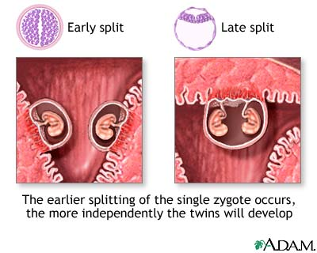
Twin Gestation
Maternal Risks
  PET or Gestational HTN
  Acute Fatty Liver
  GDMA
  Anemia
  Hyperemesis Gravidarum
  PTL and Pre-Term Delivery (50%)
Management
  Ultrasound for types of twins, Growth curve and discordance, Congenital anomalies, AFI, BPP
  Routine NST
Notes:
Monochorionic (MC) and dichorionic (DC) twin pregnancies
An accurate diagnosis of chorionicity is important, and may be more important than zygosity. MC twins have a significantly higher risk of adverse perinatal outcome and specific pregnancy complications than DC twins
MC twins are at higher risk than DC twins of neurologic morbidity, growth restriction/discordant birth weight, and cotwin death in utero [38,39] . This is due, in large part, to intertwine vascular anastomoses in the placenta.

Slide 74
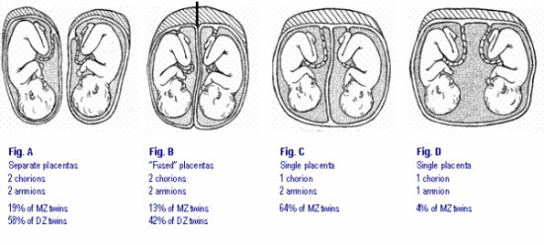
Twin Gestation
Notes:
Cord entanglement: The close proximity and absence of amniotic membrane separating the two umbilical cords makes it particularly easy for the twins to become entangled in each other’s cords, hindering fetal movement and development.[3] Additionally, entanglement may cause one twin to become stuck in the birth canal during labor and expulsion.[1] Cord entanglement happens to some degree in almost every monoamniotic pregnancy.[1]
Cord compression: One twin may compress the other’s umbilical cord, potentially stopping the flow of nutrients and blood and resulting in fetal death.[1][3]
Twin-to-twin transfusion syndrome (TTTS): One twin receives the majority of the nourishment, causing the other twin to become undernourished. TTTS is much more difficult to diagnose in monoamniotic twins than diamniotic ones, since the standard method otherwise is to compare the fluid in the sacs. Rather, TTTS diagnosis in monoamniotic twins relies on comparing the physical development of the twins

Slide 75
Twin Gestation – Mono-Mono
Division in 7-13 days post fertilization
Mono chorionic – 1 shared chorion
Monoamniotic – 1 shared amnion
Highest risk for complications: at risk for twin-to-twin transfusion syndrome

Slide 76
Twin Gestation – Mono-Di
Division in 5 – 7 days post-fertilization
Monochorionic: 1 shared chorion
Diamniotic: 2 amnions
1 shared placenta
20-33% of all twin gestations*

Slide 77
Twin Gestation – Di-Di
Fraternal or identical twins
Division in 1st 3 days post-fertilization
Dichorionic: 2 chorions
Diamniotic: 2 amnions
2 distinct placentas or 1 fused placenta

Slide 78
Twin Gestation – Labor & Delivery
Aimed before 40 weeks
CEFM
Usually Epidural is strongly recommended
Delivery in the OR and Anesthesia should be present
Risks associated with vaginal births of twins
  Acute TTTS (monochorionic twins)
  Cord prolapse if the second is breech
  Malpresentation
  Twin entrapment
  Atypical and abnormal tracing

Slide 79
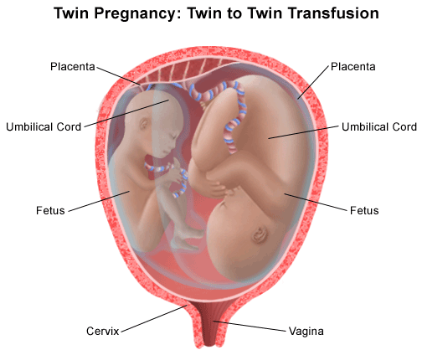
Twin Gestation - TTTS
Only in monochorionic twin pregnancy (15%) - Share single placenta
Blood transfused from one twin (donor) to the other (recipient) across the placenta
Diagnosed by ultrasound
Recipient:
  Polyhydramnios
  Distended bladder
  Cardiac failure, Hydropic
Donor:
  IUGR
  Abnormal umbilical artery doppler
  Oligohydramnios
Management
  Laser ablation to divide the superficial placental blood vessels which communicate between the twins; survival rate: 50-60%

Slide 80
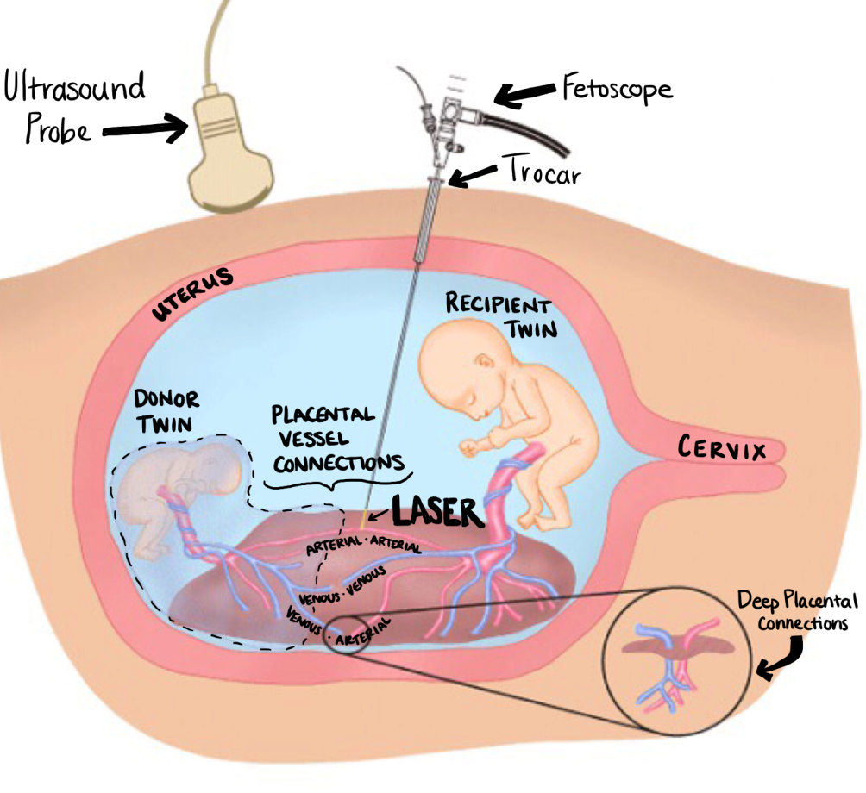
Twin Gestation - TTTS
If left untreated,
80% risk of mortality

Slide 81
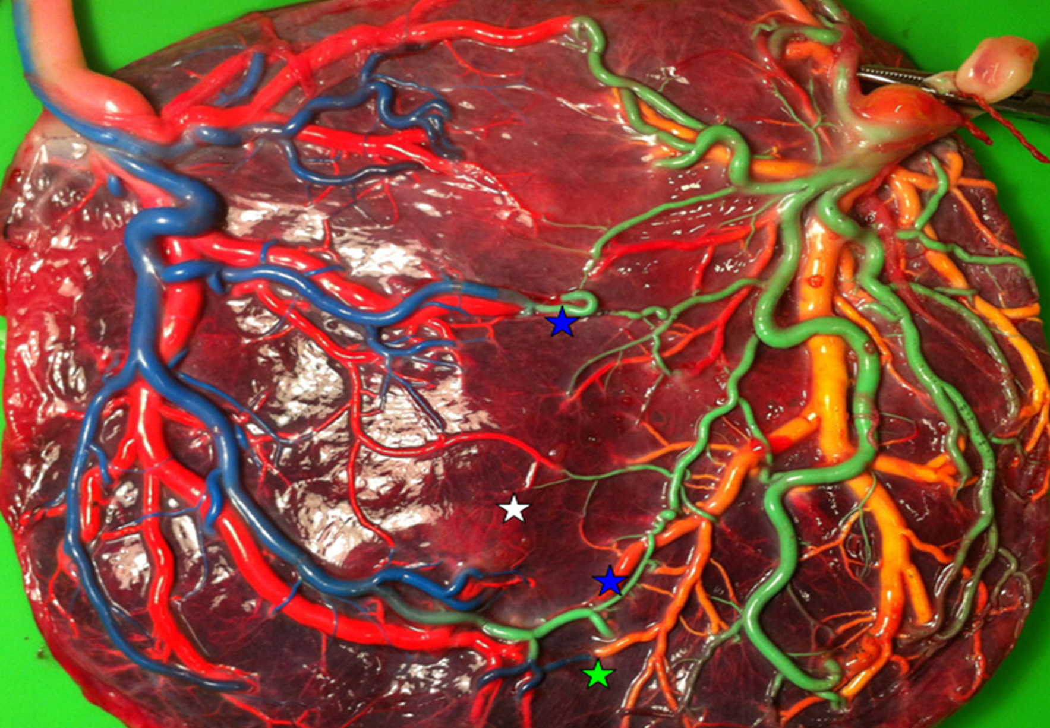
Twin Gestation - TTTS

Slide 82
Antepartum - Bedrest
limited ambulation of not more than 1-2 hours per day with bathroom and bathing permitted (but varying definitions)
Question: What are some common indications for being placed on bed rest?

Slide 83
Antepartum - Bedrest
Indications
  PTL
  Short cervix
  PPROM
  Preeclampsia
  IUGR
  Placenta previa
  Multiple gestation
  Are there risks associated with bed rest/activity restriction?

Slide 84
Antepartum - Bedrest
Widely used for a long time, despite little/no proof of its effectiveness, because thought to have little harm.
Growing body of literature demonstrating significant risks associated with BR and little evidence for its effectiveness!
Physical Risks
  Muscle and bone loss (deconditioning) - within days of immobility!
  Overall weight loss, even despite pregnancy.
  Pt appetite (Carbohydrates and fat metabolism altered)
  DVT (Pregnancy risk 5X over nonpregnant state – bed rest further adds to this risk! (0.8 per 1000 non-bedrest vs 15.6 per 1000 BR)
    TED stockings & Fragmin S/C often prescribed (if not, suggest it!)
AJOG, 2010; Maloni, 2010

Slide 85
Antepartum - Bedrest
Psychological Risks
  Increased negative feelings towards the pregnancy
  Anxiety and stress
  Separation and concerns for family at home, Emotional toll on family/family disruption, Partners report that assuming multiple roles
  Sleep disturbance
  Feelings of loss of control and Uncertainty
  Experience of time is slowed / Boredom
  Feelings of isolation and depressive symptoms
  Fear for her own outcome and that of fetus
  Minutes experienced as interminable hours
So what can we do as nurses?
AJOG, 2010; Maloni, 2010

Slide 86
Antepartum
Typical Routine

Slide 87
Antepartum - Routine
Report (census)
Go to see patients if unstable
Chart review and Plan your day (Rx, labs and other tests, monitoring, etc.)
Follow-up on consultations, test requisitions/results
Update Census / Kardex
Meals and snack distribution
Empty bedpans and fill the rooms of blue pads and other equipment
Verify PET and emergency cart as needed (i.e. crash cart, delivery cart ) monthly or following use
Identify patients to be weighed on weight sheet (front desk) for Monday a.m.; add new admissions throughout the week

Slide 88
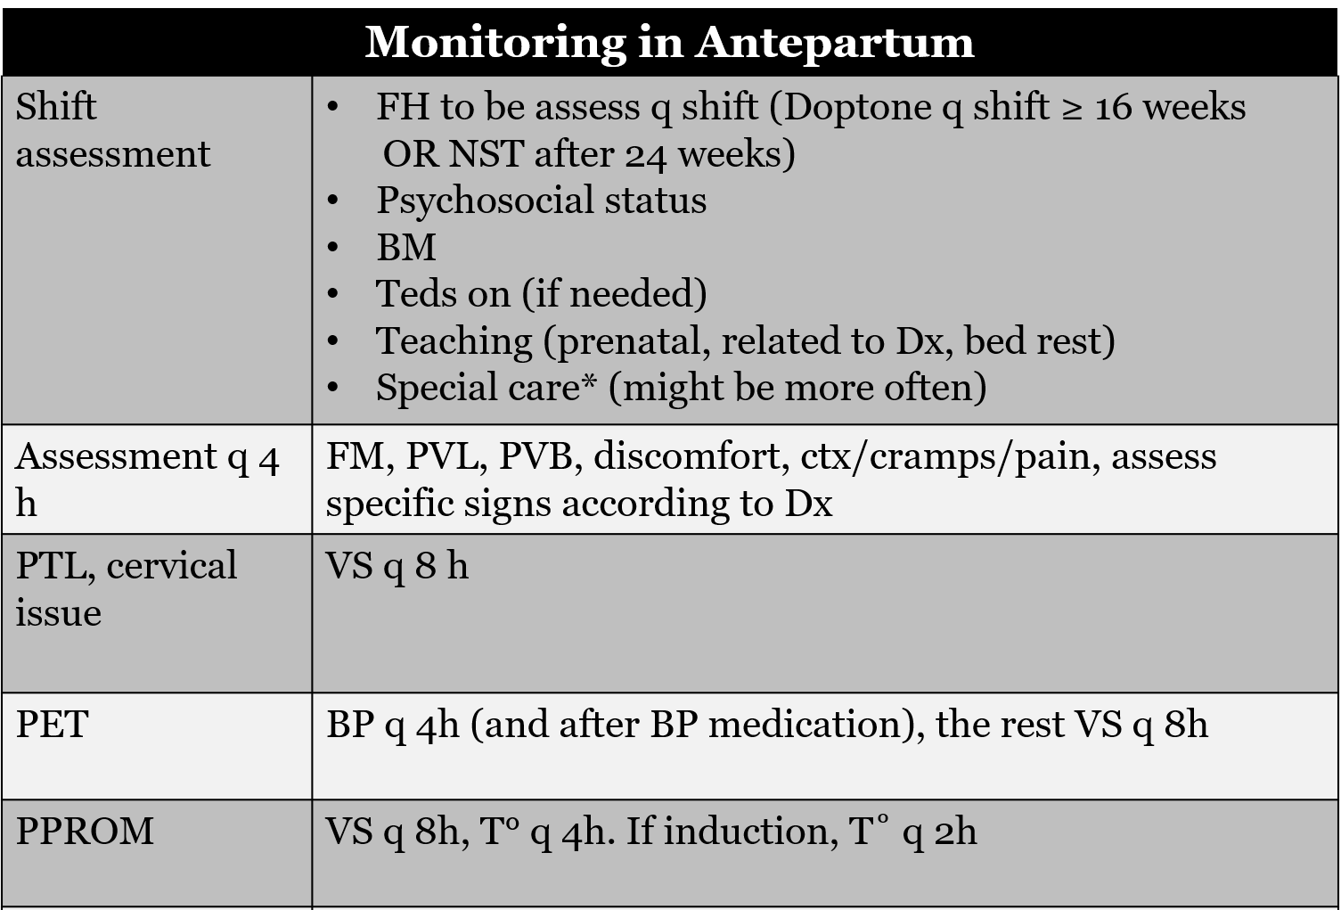
Antepartum - Routine
USE YOUR CLINICAL JUDGEMENT !!!
MONITORING SHOULD BE ADJUSTED ACCORDING TO PATIEN’S CONDITION

Slide 89
Antepartum
Documentation – Let’s look at a chart
Admission
Discharge - Teaching

Slide 90
Antepartum – Discharge Teaching
Go to hospital immediately if:
  Any S & Sx of PTL - DESCRIBE what it might feel like
    Contractions or cramps become more frequent than 8 in one hour or 4 in 20 minutes
    Cramps or low backache or tightening that may come and go or stay constant
    Pelvic Pressure
  DFM
    Less than 6 FM in 2hrs OR Less than what is HER usual
  PVL or PVB change in vaginal discharge
    Spotting is normal after VE or intercourse
  PET Sx
    Severe h/a which is not relief 30 minutes after taking Tylenol
    Blurry vision or spots
    Severe heartburns or pain on the upper right side of your abdomen that is not relief with antiacid
    Increase swelling in your face, hands or feet
    Decrease urinary output or dark colored urine
Patient can call the BC if they have any concern

Slide 91
Thank You

