Slide 1
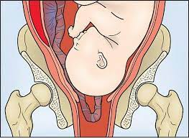
Obstetrical emergencies : Cord Prolapse

Slide 2
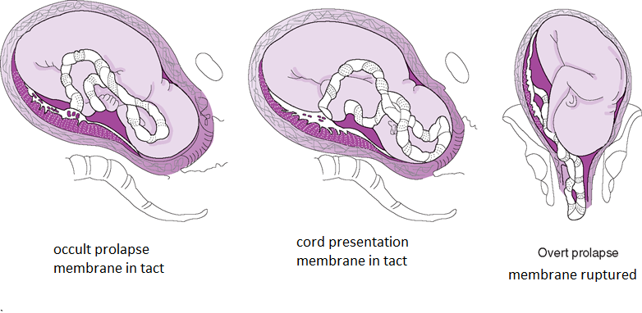
Definition and types
Presentation of the umbilical cord below or adjacent to the fetal presenting part.
Types of umbilical cord prolapse:
Notes:
Overt umbilical cord prolapse – refers to protrusion of the cord in advance of the fetal presenting part, often through the cervical os and into or beyond the vagina. The fetal membranes are invariably ruptured in these cases and the cord is visible or palpable on examination.
Occult prolapse occurs when the cord descends alongside, but not past, the presenting part. It can occur with intact or ruptured membranes. The diagnosis should be considered in the differential diagnosis of a sudden, prolonged fetal heart rate deceleration. An occult prolapse often cannot be diagnosed with certainty, but is suggested by clinical features (eg, fetal bradycardia) and findings at cesarean delivery.

Slide 3
Risk factors
Malpresentation
Polyhydramnios
Preterm gestation
Grand multiparity (i.e., parity of ≥5)
Male gender
Pelvic tumors
Partial placenta previa
Low-lying placenta
Cephalopelvic disproportion
Multiple gestation
Preterm rupture of membranes
Cord prolapse has been associated with:
ARM
Scalp electrode application
Intrauterine pressure catheter insertion
Attempted external cephalic Version
Expectant management of PPROM
Manual rotation of fetal head
Amnioreduction

Slide 4
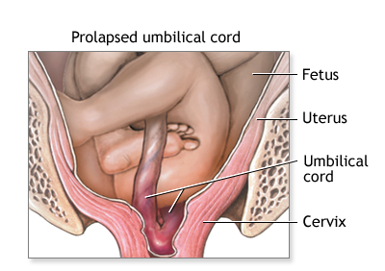
Presentation
Sudden fetal heart rate deceleration in women with ROM (often the first indicator of cord prolapse).
Visualizing the cord through the introitus
Palpation of the cord in the vagina
Palpation of the cord through the membranes
Finding on ultrasound
Occult cord prolapse must be suspected in all patients with persistent or significant decelerations on fetal heart monitoring. Variable decelerations with contractions associated with a prompt return to baseline is often seen with occult cord prolapse.
Notes:
Introitus= cervical os
Sudden fetal heart rate deceleration in women with ROM (often the first indicator of cord prolapse).: intrauterine resus intervention and v.e.
Prompt= rapide

Slide 5
Presentation
Head is not well engaged and membranes are ruptured
Advise patient to not ambulate

Slide 6
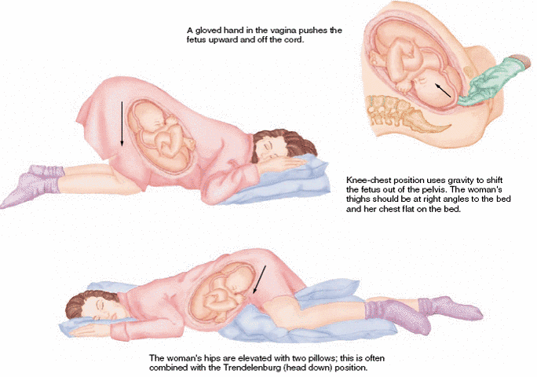
Management
Prevention/review risk factors
Call for help STAT: Do not leave the patient alone!!
Place mother on chest-knees position or Trendelenburg to avoid compressing the cord
Reach into the vagina and push the presenting part back into the pelvis to remove the pressure from the umbilical cord
Start IV with NS (18G) if not already done
Transfer to BC OR stat
Notes:
health care provider places direct vertical pressure: any one (rn or md)

