Slide 1
What is the difference between a TOLAC and a VBAC ?

Slide 2
TOLAC
TRIAL OF LABOUR AFTER C-SECTION

Slide 3
VBAC
VAGINAL BIRTH AFTER C-SECTION

Slide 4
Risks and Benefits
Benefits TOLAC
Shorter hospital stay
Lower risk of infection
Less blood loss
Benefits of elective repeat CS
Overall lower risk for baby
Risks of TOLAC
Uterine rupture (1%)
Hysterectomy
⬇ O₂ for baby (50%)
Risks if CS needed during TOLAC
(vs elective repeat CS)
Higher risk of bleeding
Higher risk of infection
Higher risk of surgical injury

Slide 5
Factors that increase the likelihood of a successful VBAC
Previous successful VBAC
Previous vaginal delivery
BMI <30
Birth weight <4000 g
Spontaneous onset of labour
Indication for previous CS (breech presentation) not present in current pregnancy
Maternal age < 40 years
Factors that decrease the likelihood of a successful VBAC
Previous CS performed for labor dystocia
Need for induction of labour requiring cervical ripening
Need for augmentation of labour
Gestational age > 40 weeks
Estimated birth weight > 4000 grams
BMI > 30
Maternal hypertension

Slide 6
What is the most dangerous complication of a TOLAC ?

Slide 7
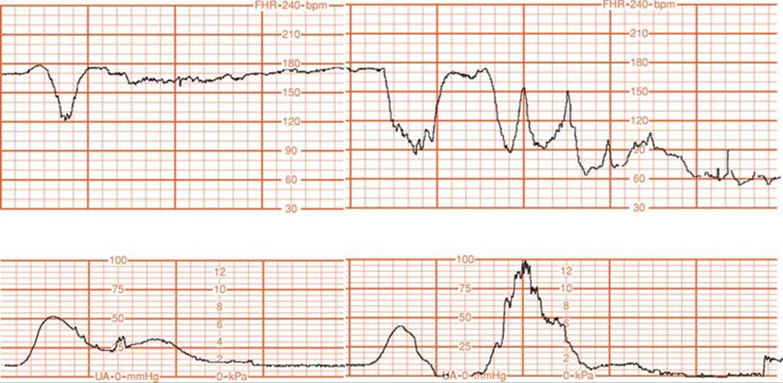

Slide 8
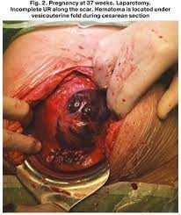
Uterine Rupture
The complete separation of the myometrium with or without extrusion of the fetal parts into the maternal peritoneal cavity.
  Hyperstimulation with large doses of Oxytocin IV is also a risk factor !!

Slide 9
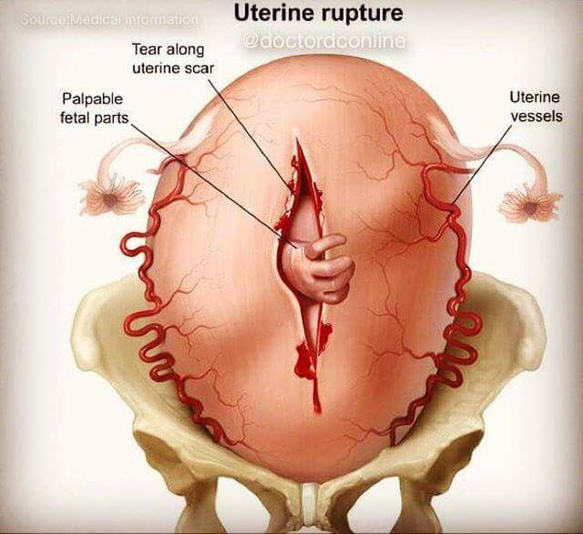
Signs of uterine rupture
  1st sign usually abnormal FHR
  Constant acute abdominal pain
  or pain at the rupture site
  Chest pain or shoulder tip pain
  Vaginal bleeding
  Hematuria
  Irregular abdominal wall contour
  Loss of fetal station
  Maternal signs of hypovolemic shock : tachycardia, hypotension

Slide 10
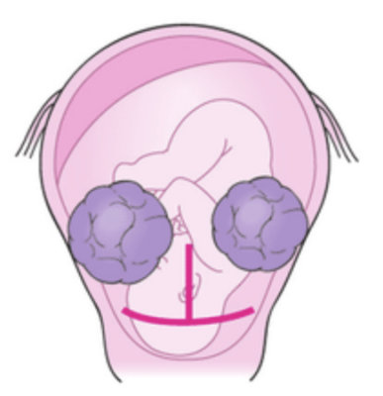
Increased risks of uterine rupture
Not all patients are optimal candidates for TOLAC :
Previous classical/inverted T incision
Previous extensive uterine surgery
Patient doesn’t consent to TOLAC
Cesarean section in the past 18 months
2 + previous cesarean sections
All patients should have a discussion with their primary physician in order to make an informed decision

Slide 11
Uterine Rupture
Impact:
  Maternal hypovolemic shock
  Infection
  Fetal hypoxemia & hypoxia
  Neurological impairment of the fetus
  Fetal compromise- uteroplacental insufficiency
  Possible hysterectomy
  Maternal and fetal death

Slide 12
Interventions – Uterine rupture
Prompt identification of possible uterine rupture is essential
Inform the medical team accordingly
Anticipate fluid resuscitation/administration of blood products (2nd IV access, blood work up, xmatch, etc)
Monitor maternal vital signs and fetal heart rate closely
Perform intrauterine resuscitation measures if needed
Bring patient to OR STAT once uterine rupture is suspected/confirmed

Slide 13
Specific interventions/care for TOLAC
  Patient should be counselled and consented for TOLAC by treating physician
  Upon admission :
  OB history : reason of previous c/s, previous VBAC, etc
  Pain assessment & teaching : Assess and describe the different types of pain the patient should be aware of (incision pain, shoulder pain, chest pain)
  IV access: large gauge IV + Cross-match
  During labor :
  Monitor the progress of labor with the TOLAC partogram
  If induction of labor : contraindication for Cytotec (Misoprostol) and Cervidil (Dinoprostone)
  Maximum dose of Oxytocin IV : 20mu/min
  Delay ARM as long as possible
  Ensure adequate pain management

Slide 14
TOLAC Partogram
Start TOLAC partogram when patient is 4cm dilated or more and is experiencing regular contractions

Slide 15

Special considerations
Explore the emotional component of the TOLAC : keep in mind some parents have expectations and hopes.
Include and update them as much as possible in regards of the plan of care.

