Slide 1
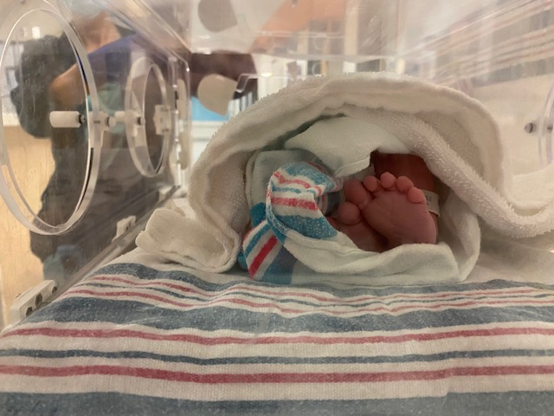
Labor & Delivery : The Basics

Slide 2
First trimester
(0-13 weeks)
Second trimester (14-27 weeks)
Third trimester (28-40 weeks)
Pregnancy
Physiological Changes in Pregnancy
https://www.youtube.com/watch?v=A0sp7I9rlz8&t=2s

Slide 3
Common abbreviations: Obstetrical history
G (Gravida) | Number of times a woman has conceived, including any current pregnancy
P (Para) | Number of times a woman has given birth after 20 weeks of pregnancy
T (Term) | Number of times a woman has carried a pregnancy to at least 37 weeks and delivered
P (Preterm) | Number of times a woman has delivered before 37 weeks but after 20 weeks gestation
A (Abortions) | Number of times a woman has lost a pregnancy, whether it was elective or spontaneous (miscarriage) before 20 weeks
L (Living children) | Number of living children to this day

Slide 4
Common abbreviations: Labor & delivery
IOL : Induction of labor
SRM : Spontaneous rupture of membranes
ARM : Artificial rupture of membranes
TOLAC/VBAC : Trial of Labor After Cesarean Section/Vaginal Birth After Cesarean Section
IUFD : Intrauterine fetal demise
SGA/LGA : Small for gestational age/Large for gestational age
Ctx : Contractions
VE : Vaginal exam
FHR : Fetal heart rate CFHM: Continuous FH Monitoring

Slide 5
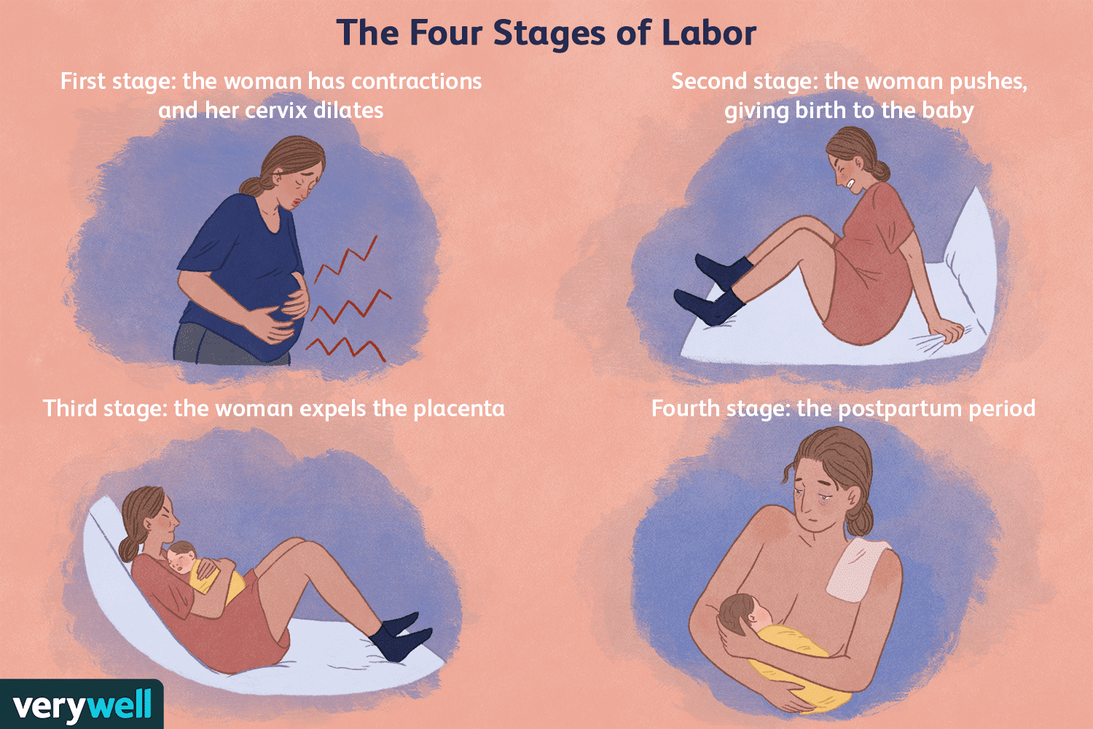
Labor stages

Slide 6
First stage of labor
Early (latent) : 0-3 cm | Happy, talkative, excited Pain and intensity start to build Independent
Active : 4-8 cm | Pain intense – feelings of helplessness, fear, anxiety Fatigue More dependent, needs support Needs different strategies to cope with the pain
Transition : 7/8-10 cm | Contractions are more frequent and intense Feels vaginal and rectal pressure, bloody show Irritable, ”out of control” Wants to quit Introspective

Slide 7
True vs False Labor
True labor
False labor
Contractions occur at regular intervals
Interval gradually shortens
Intensity of pain gradually increases
There is progressive cervical effacement and dilatation
Progress of labour not stopped by sedation/pain medication
Contractions occur at irregular intervals
Interval remains irregular
Intensity of pain remains the same
Duration of contractions varies and tends to become less
There is no progress in cervical effacement and dilatation
Usually painful contractions are relieved by sedation/pain medication

Slide 8
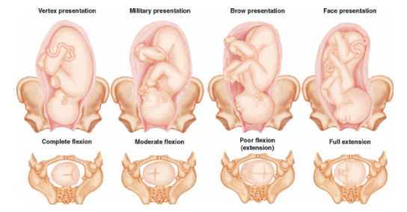
Fetal presentation
VERTEX
FACE / BROWE PRESENTATION – OBSTETRICS (home.blog)

Slide 9
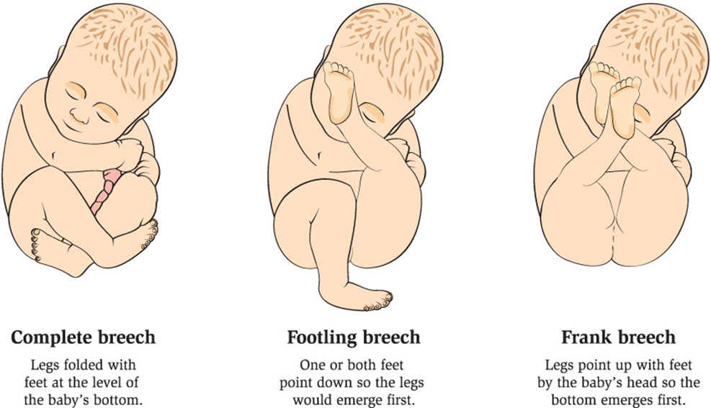
Fetal presentation
BREECH

Slide 10
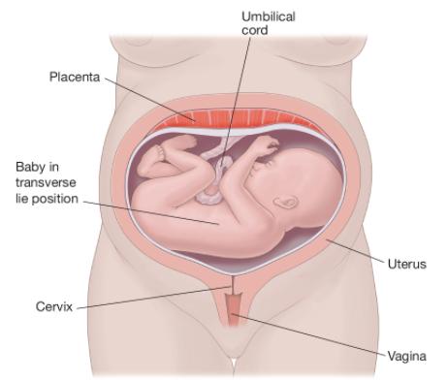
Fetal presentation
TRANSVERSE

Slide 11
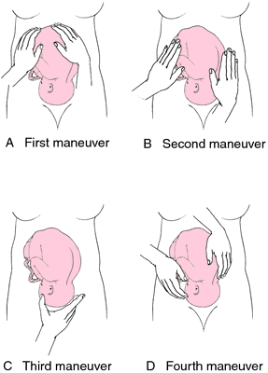
Fetal presentation : Leopold’s maneuver
https://www.youtube.com/watch?v=KQ3L1n5XiLw&t=4s

Slide 12
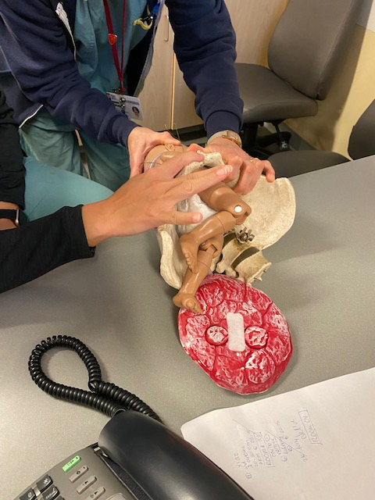
Vaginal exams
Indications
To assess favorability of cervix before induction
To administer vaginal prostaglandins during induction of labor
To confirm onset of labor
To assess progress of labor
To identify the presenting part and position of the baby
To perform artificial rupture of membranes (ARM)
To apply a fetal scalp electrode
To perform a fetal blood sample
To exclude cord prolapse after SRM where there is an ill-fitting presenting part
To confirm onset of second stage
During postpartum care to assess a woman’s source of bleeding (retained placenta or clots)
** Physicians will review the most recent ultrasound report to ascertain placental location

Slide 13
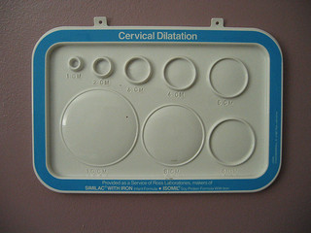
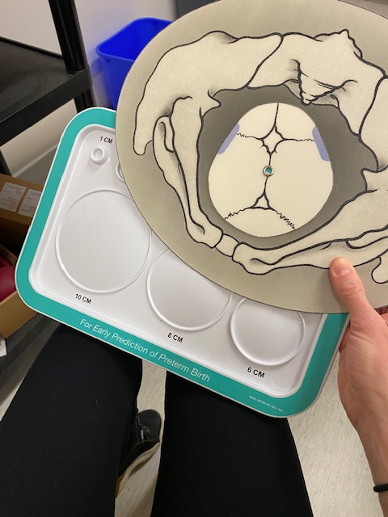
Vaginal exams : Cervix dilation

Slide 14
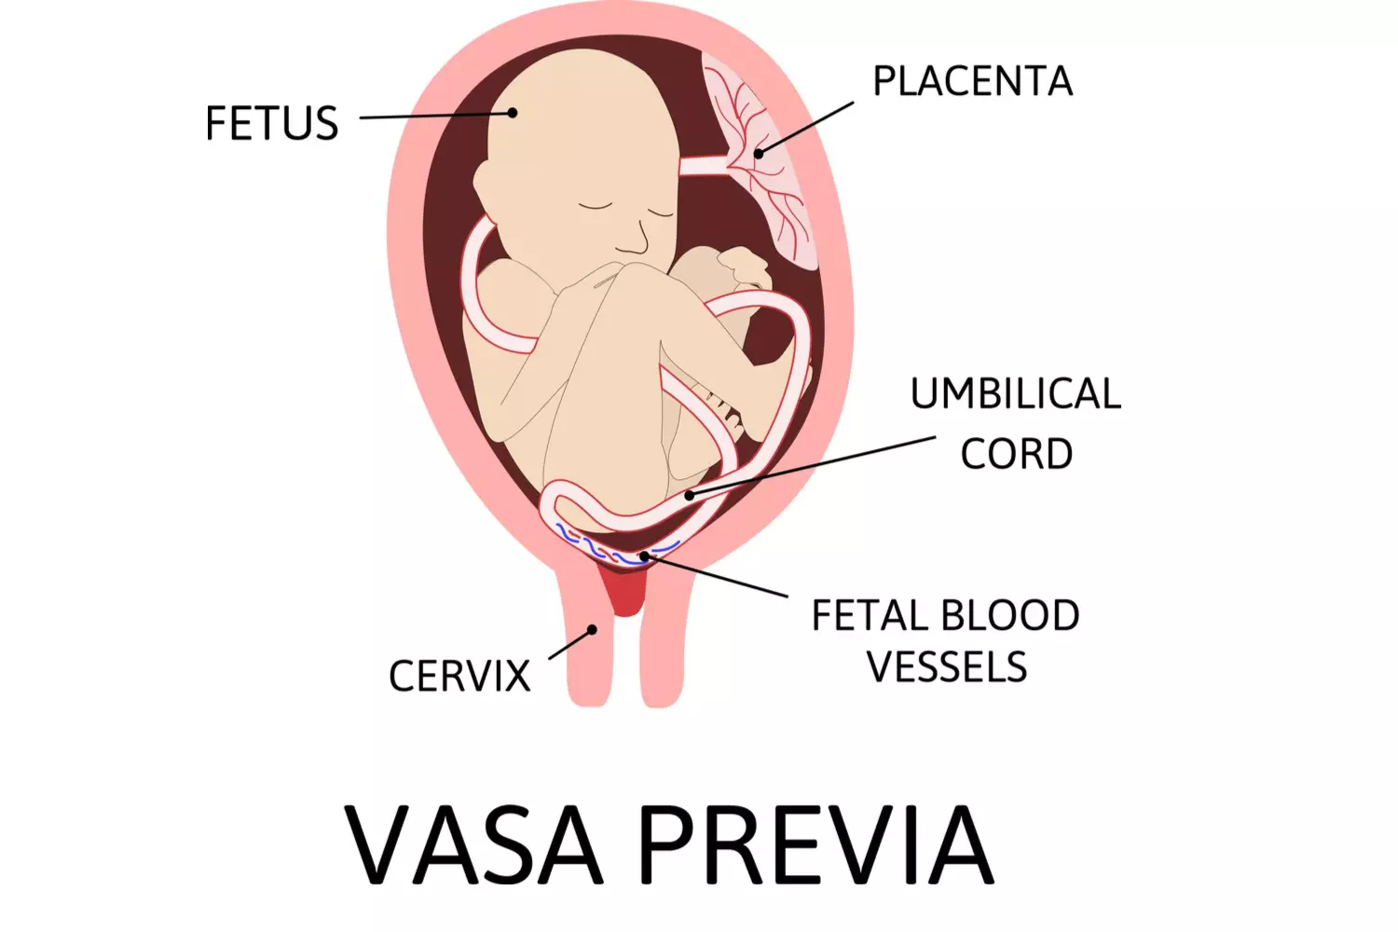
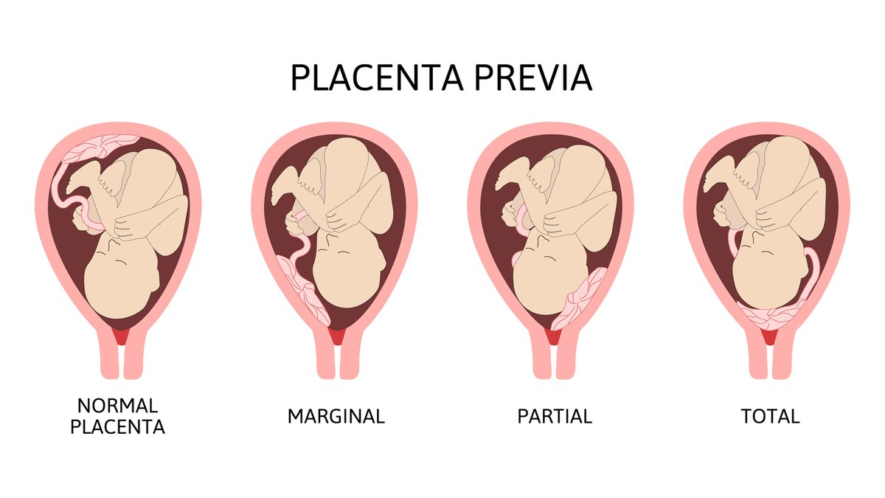
Vaginal exams
Contraindications
Known or suspected vasa previa
Known or suspected placenta praevia
Acute vaginal bleeding on admission
Blisters or raised vesicles on the labia : Herpes virus infection may be present
For nurses : Preterm patients (≤ 36 weeks)
**** In these circumstances, a speculum examination by a senior resident (MFM) or attending staff must be performed prior to a digital vaginal examination. ****

Slide 15
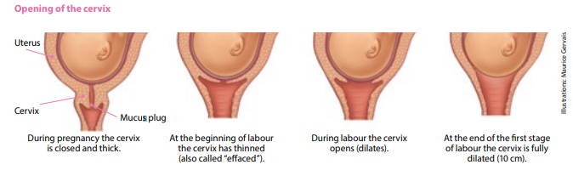
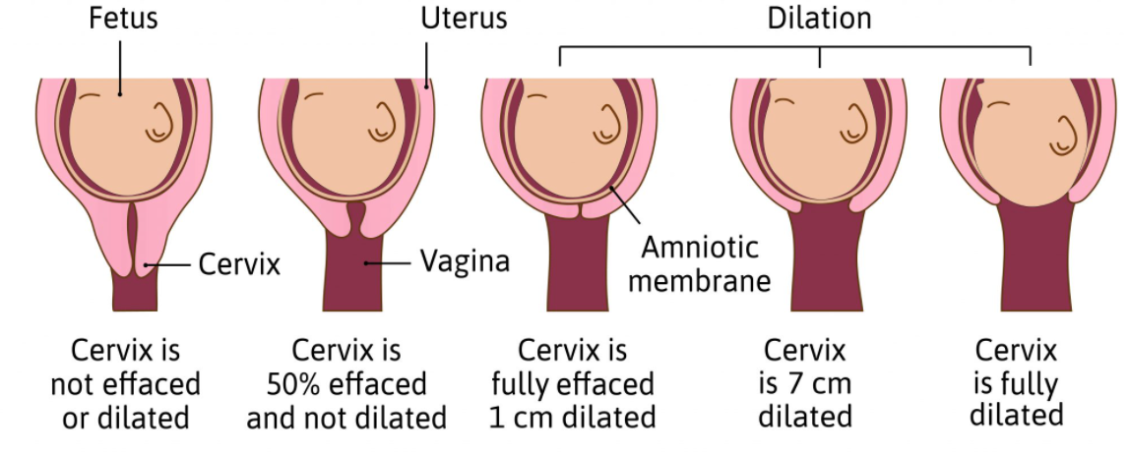
Labor progress
Vaginal exam:
Effacement, from 0 to 100%
Cervical dilatation, from 0 to 10cm
Cervical consistency (soft, medium, hard)
Cervical position (Anterior, mid, posterior)
Fetal station, from -4 to +4
Fetal presentation (cephalic, breech, transverse)

Slide 16
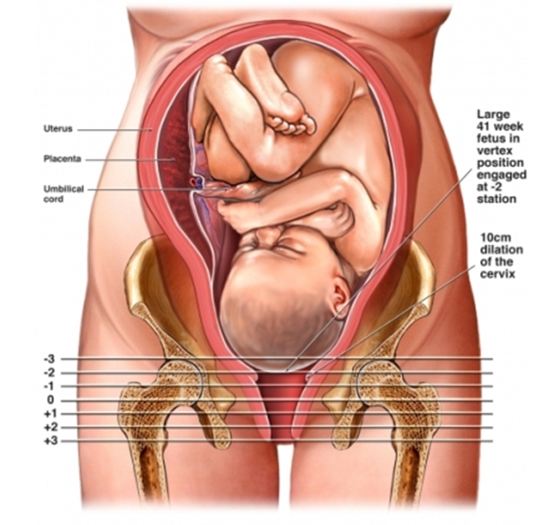
Vaginal exams : Fetal Station

Slide 17
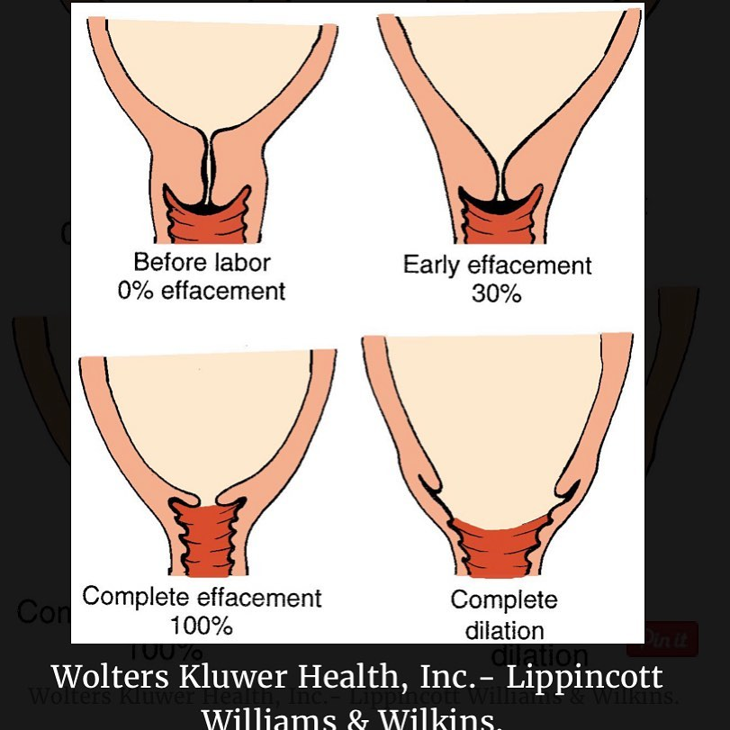
Vaginal exams : Cervix effacement

Slide 18
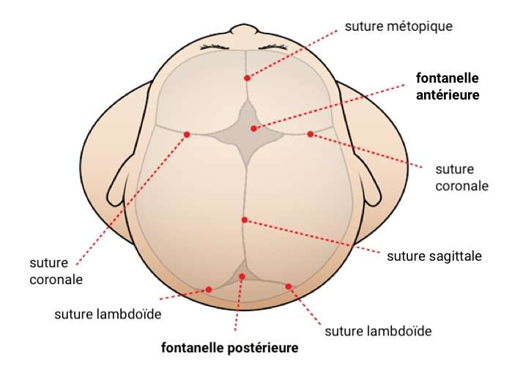
Vaginal exams : Fetal presentation

Slide 19
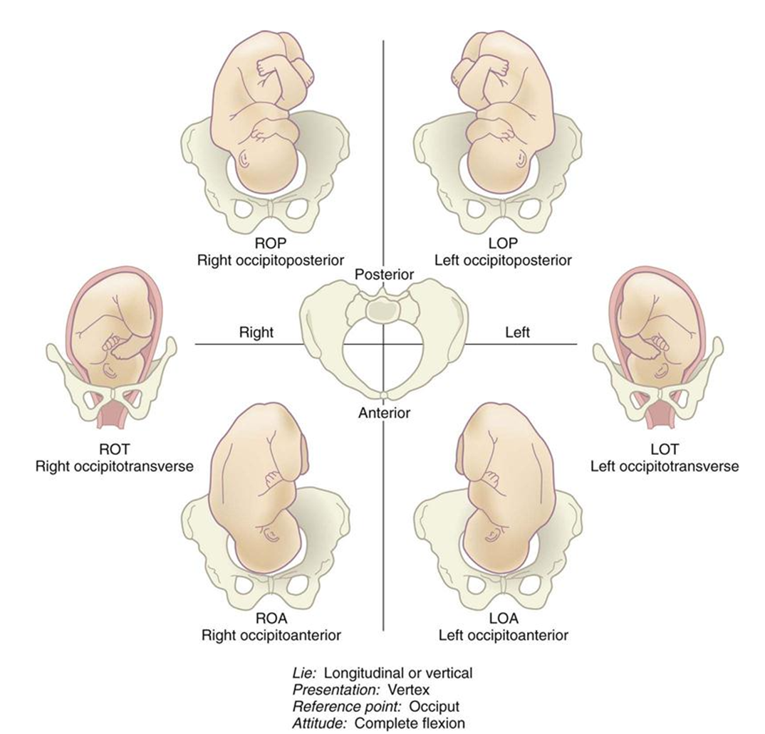
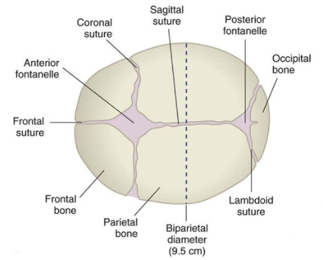
Fetal presentation

Slide 20

Summary
Youtube

Slide 21
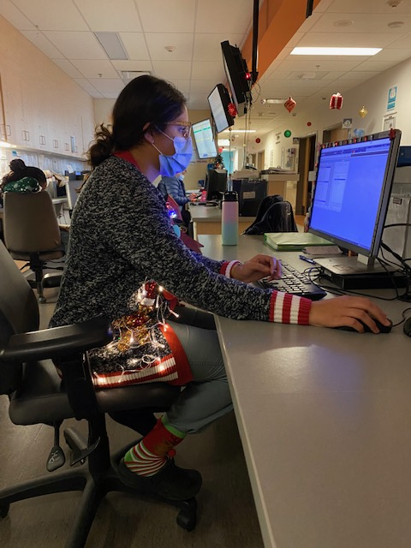
Charting in Centricity
The Birthing Center board
Vaginal exams
Fetal presentation

Slide 22
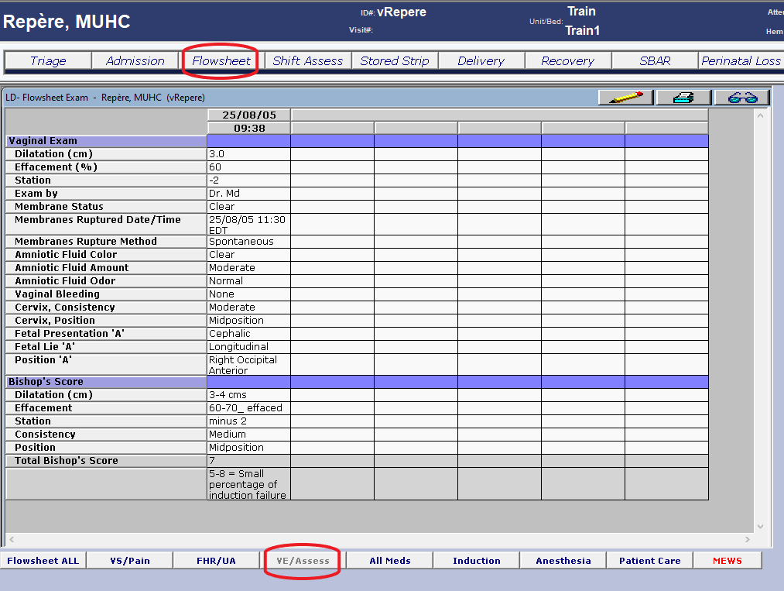
Charting in Centricity

Slide 23
Sources
https://www.medicalnewstoday.com/articles/323742
https://www.verywellfamily.com/stages-of-labor-2752957
Birthing Center Orientation Day 1: Induction and Augmentation of Labor PowerPoint by Ruth-Lynn Fortune NPDE

